Slide 1
City of Petersburg Emergency Financial & Operational Restructuring
Presentation to Petersburg City Council
The Robert Bobb Group, LLC
October 2, 2017
FINAL PRESENTATION

Slide 2

Agenda
Forensic Audit Report – PB Mares, LLC
RBG Report on Deliverables Completion
5 Year Financial Plan
Internal Auditor
Collector Transition Plan
RBG Accomplishments
Technology Framework for the City
Opportunities for the City
Closing Statement
Transparency
  All RBG Presentations are available on the City website: http://www.petersburgva.gov/index.aspx?NID=846

Slide 3
Forensic Audit Executive Summary
PB Mares, LLC
Forensic Audit Summary

Slide 4
Forensic Audit Executive Summary
We encourage the City Manager and the City Council to carefully review and implement the detailed recommendations in Section VI on pages 47 – 61.
The City contracted with PB Mares in April 2017 after a competitive Request for Proposals (RFP) procurement process conducted by the City. Six proposals were received from national and local firms.
NOTE: Forensic Audit scope did not include an examination to determine what caused Petersburg to decline into a fiscal crisis. And, it did not include a forensic audit of all City Departments, Agencies.
Source: Audit Report is located on the City’s Website http://www.petersburgva.gov/DocumentCenter/View/2882

Slide 5
Forensic Audit Executive Summary
We encourage the City Manager and the City Council to carefully review and implement the detailed recommendations in Section VI on pages 47 – 61.
Auditors Applied the “Fraud Triangle:”
  Opportunity: ability for a person to engage in misconduct or fraud.
    “Petersburg’s internal controls have traditionally not been strong and there are many employees who have been in roles for lengthy periods of time (some exceeded 30 years), such that they were able to tell us ways in which existing internal controls might be circumvented…”(p.4)
  Rationalization: person’s ability to internally justify wrongful actions
    “We found the perception of “ethical tone” in Petersburg was not strong/positive, with many historical instances or allegations of misconduct reported to us and or identified in public records of investigations of misconduct of Petersburg Officials, Leaders and/or employees…” (p.5)
  Pressure: relates to a financial need within a person’s life that they do not perceive can be shared with an employer
    “one person we interviewed, who has access to cash, takes home slightly over $1,000 per month, making it extraordinarily difficult for that person to meet just his/her essential living needs…”(p.5)
Source: Audit Report is located on the City’s Website http://www.petersburgva.gov/DocumentCenter/View/2882

Slide 6
Forensic Audit Executive Summary
We encourage the City Manager and the City Council to carefully review and implement the detailed recommendations in Section VI on pages 47 – 61.
Examination of Water and Waste Water Billings and Collections
  “Findings are based solely on interviews of some current employees who were involved with that contract (at lower levels), as well as a review of relevant documents and data.”
  “Our examination did not identify any red flags indicative of a quid-pro-quo or misconduct associated with the procurement process (which was changing amid this time-period) and final selection of the vendor for the water meter replacement contract..” (p.6)
  “It appeared that the objectivity and judgment of the Public Works personnel assigned to the procurement committee for the water meter contract could have been affected in favor of the project’s ultimate winner.” (p.6)
  “Nonetheless, it appeared that the firm that won this contract was capable and qualified and was the lowest bidder of the two most apparently qualified bidders identified by the City in the procurement process.” (p.6)
Source: Audit Report is located on the City’s Website http://www.petersburgva.gov/DocumentCenter/View/2882

Slide 7
Forensic Audit Executive Summary
We encourage the City Manager and the City Council to carefully review and implement the detailed recommendations in Section VI on pages 47 – 61.
Implementation of the Water Meter Contract
  “Our examination found that it was an extraordinarily complex project for which the City personnel involved did not appear prepared for or experienced in managing. The project appeared to have been very poorly planned and managed by Public Works, but not by the vendor.” (p.6)
  “While there were no indicators of misconduct, fraud, waste or abuse noted during our examination of the water meter replacement contract, we did find that some Public Works employees had relationships with the vendor that would ordinarily violate a “Conflict of Interest” and/or “Gifts and Gratuities” policy. Some of the actions referred to included:” (p.7)
    payment by the vendor for meals or entertainment of Public Works employees, sharing of
    information about other job opportunities, and allowing a Public Works employee to
    attend conferences under the vendor’s contract (apparently to avoid paying the
    conference registration fee).
Source: Audit Report is located on the City’s Website http://www.petersburgva.gov/DocumentCenter/View/2882

Slide 8
Forensic Audit Executive Summary
We encourage the City Manager and the City Council to carefully review and implement the detailed recommendations in Section VI on pages 47 – 61.
City Management directed us to file a complaint with the Federal Bureau of Investigation (FBI) on behalf of the City. We provided all the relevant information to the FBI and were authorized by the City to assist them if so requested.
Treasurer’s Office
  “We identified within the Treasurer’s Office two relatively significant dollar value thefts and a possible much larger scheme whereby many tens of thousands of dollars could have been misappropriated.” (p.7)
  “As it concerned the theft(s), they involved the stealing of $2,371.44 in petty cash in the Treasurer’s Office.” (p.8)
  “Internal controls in the Treasurer’s Office are weak and all six (6) of the employees within that office had access to petty cash.” (p.8)
  “Ultimately, the City Treasurer admitted to us that he had stolen the petty cash.” (p.8)
  “…City Treasurer would inappropriately waive tax penalties, interest, and sometimes principal (effectively an “abatement” of taxes). Of prime concern was that doing so in such manner would have allowed the City Treasurer to misappropriate portions of or whole cash tax payments while concealing it on the City’s books and records.” (p.8)
  The City Treasurer admitted to us that he had done these waivers knowing that it was impermissible and/or a violation of the Code of Virginia, but denied that he had misappropriated any City funds other than petty cash.” (p.8)
Source: Audit Report is located on the City’s Website http://www.petersburgva.gov/DocumentCenter/View/2882

Slide 9
RBG Report on Deliverables Completion
RBG Report on
Deliverables Completion

Slide 10
RBG Deliverables: What We Found
It has been our great honor to serve you and the City of Petersburg in its financial and operational restructuring.
Our focus Since Day 1 on October 25, 2016:
  Structurally Balanced Budget & Stabilized Overall Financial Operations
  Debt Restructuring and Access to Capital Markets
  Public Safety
  Full Transparency of all Data and Information
  Focus on Operational Efficiency
  Identified Weaknesses and Recommended Improvements in Technologies (i.e. OpenGov, CitiWorks, etc.)
  Pay Vendors including Negotiating Payment Plans with State and Regional Partners
  Managed day-to-day operations
  Reviewed past analytical work to determine path forward (i.e. PFM, Government’s Technical Team)

Slide 11
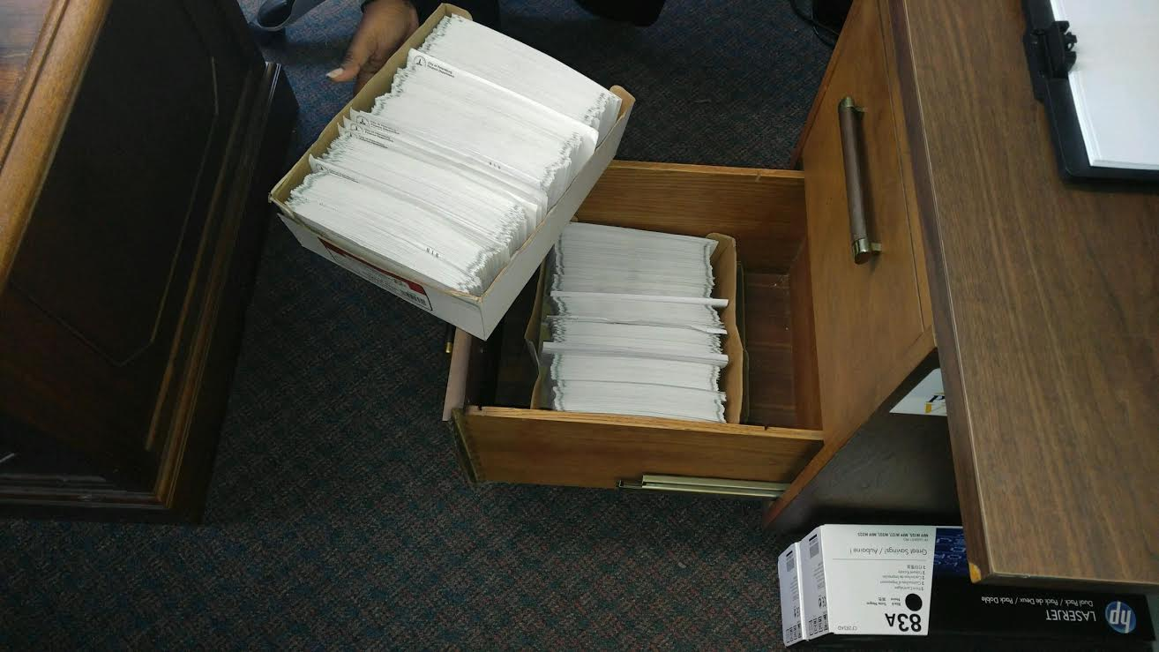
Financial Operations – What We Found
When RBG started work on 10/25/16, we observed no understanding of the staffing challenges created by the challenged leadership and the institution of the 10% reduction of salaries. We observed a lack of data analytics in decision-making, a lack of internal controls for cash management/accounts payable, and the erosion of basic processes and accounting principles for financial management.
This is a picture of real “checks in the drawer” for unpaid bills going back to January 2016. Checks were issued but not released to the vendor due to lack of sufficient cash balance.

Slide 12
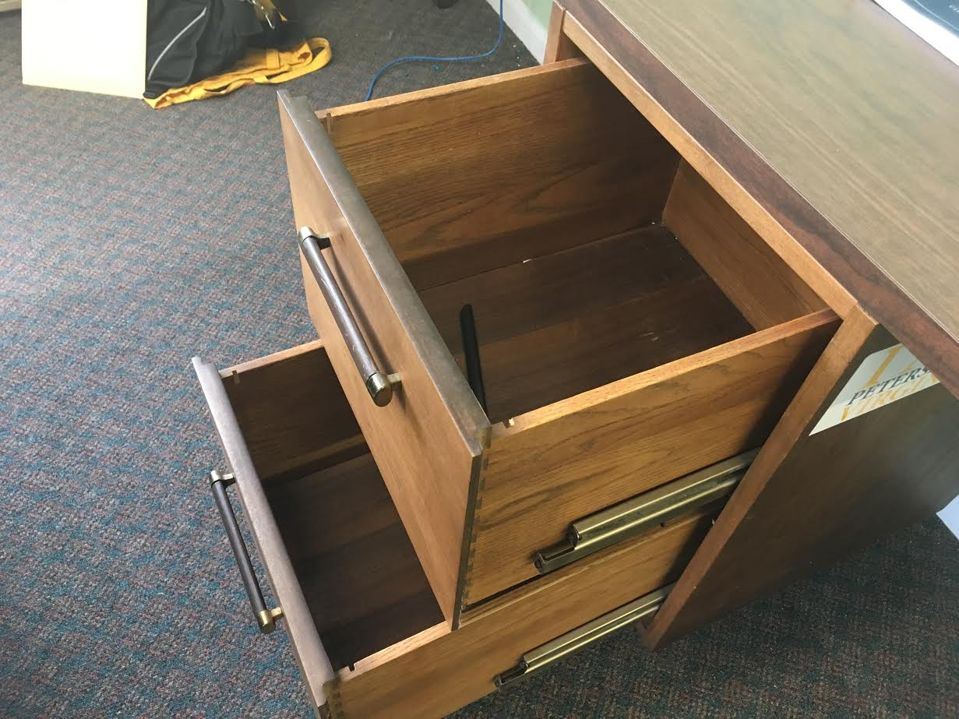
Financial Operations – What We Did
RBG instituted a weekly process to review batches of invoices and determine what checks are to be paid, while validating the availability of cash. This must be signed off by Interim DCM/Finance Director. The result is that there are no more checks in the drawer waiting to go out!
RBG developed a vendor repayment plan to repay outstanding obligations over the next 12 months (starting in March 2017).

Slide 13
RBG Report on Deliverables Completion
Since Day 1, we delivered 20+ Council Presentations.
We committed to full transparency from the very beginning. All of our reports can be found at: http://www.petersburgva.gov/index.aspx?NID=846
All RBG deliverables, presentations and data analysis are posted to the City's Dropbox account titled "City of Petersburg - Data Room." The folder is titled "The Robert Bobb Group, LLC Deliverables.“
Those reports, including tonight’s presentation, should be archived as part of the City’s permanent record.
Tonight we present our deliverable reports. These reports state our contractual list of deliverables and include additional deliverables we provided to the City.

Slide 14
RBG Key Accomplishments (1 of 2)
Cleared Hurdles that threatened Insolvency
Stabilized the financial situation by securing a cash flow note (RAN), Drew Capitalized Interest, Negotiated Settlements with Vendors and Authorities
Amended FY 2017 Budget for the 2nd Time and Developed Structurally Balanced and Conservative Budget for FY 2018
Developed a Capital Budget and 5-Year Capital Improvement Plan that incorporated financing and funding mechanisms to enable implementation
Restructured Debt for Immediate Budgetary and Cash Flow Flexibility

Slide 15
RBG Key Accomplishments (2 of 2)
Improved Credit Rating Outlook from “Negative” to “Stable” which has already resulted in improvement interest rates and costs of short term borrowing (RAN)
Secured financing for critical emergency vehicles
Undertook a comprehensive evaluation of the City’s utility system to include a rate study, infrastructure plan, and billing & collections strategies (which have increased collection rates from 70% to 86%)
Provided a Plan with recommendations and alternatives for a significant liquidity event to bolster the City’s financing that would have increased reserves and enhance City’s bond rating in near term (i.e. PPEA process, selling excess water capacity, and a plan to accelerate sale of real estate to include over $4.0M in real estate transactions)
One-Time Revenues or Cost Avoidances equal to $10.0M

Slide 16
RBG Impact: Savings & Cost
Avoidance Over $10 Million
Item Description | Amount
VRA Capitalized Interest Returned to the City | $1,300,000
Department of Social Services State Reimbursement | $625,000
State Funding Assistance | $420,210
DEQ Grant | $200,000
Match Requirement Waived | $3,300,000
Regional Jail Penalty Waived | $60,000
Debt Service Restructuring | $2,000,000
Sale of Surplus Vehicles | $60,000
Resolved Impasse over Fire Programs to Receive Funds | $280,000
Additional Annualized Revenue from Increase in Utilities Billing Collections | $1,500,000
Increase Landfill Revenues | $30,000
Savings from Implementing New Health Care Plans in the FY 2018 Budget | $300,000
TOTAL RBG SAVINGS AND COST AVOIDANCE | $10,075,210

Slide 17
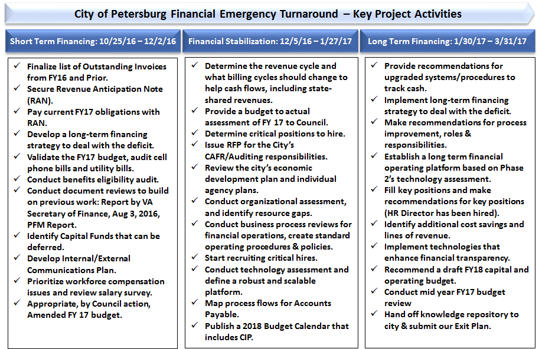
RBG Phase 1 Deliverables

Slide 18
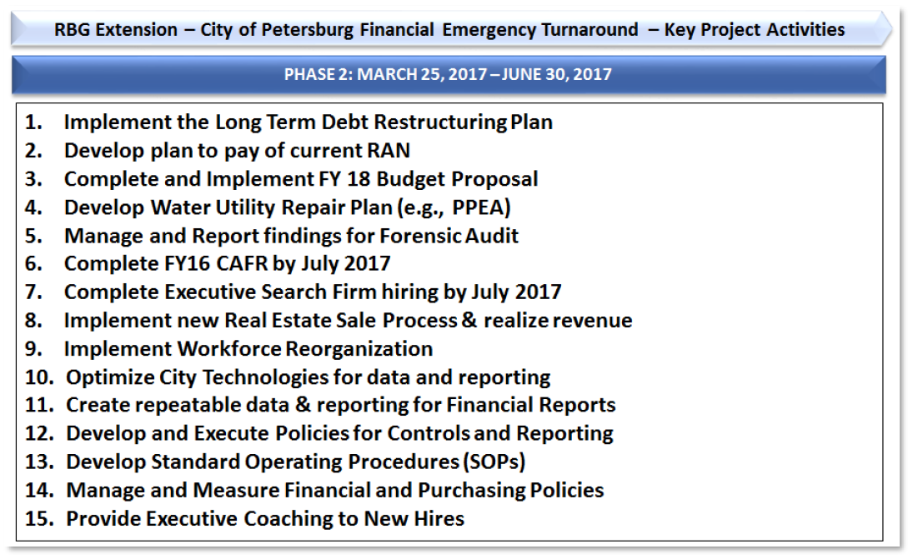
RBG Phase 2 Deliverables – Contracted

Slide 19
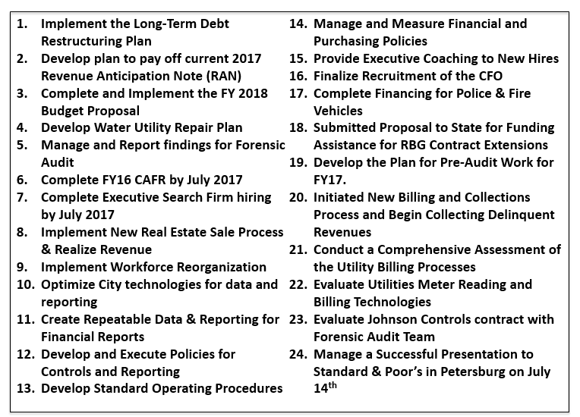
RBG Phase 2 Deliverables – Delivered

Slide 20
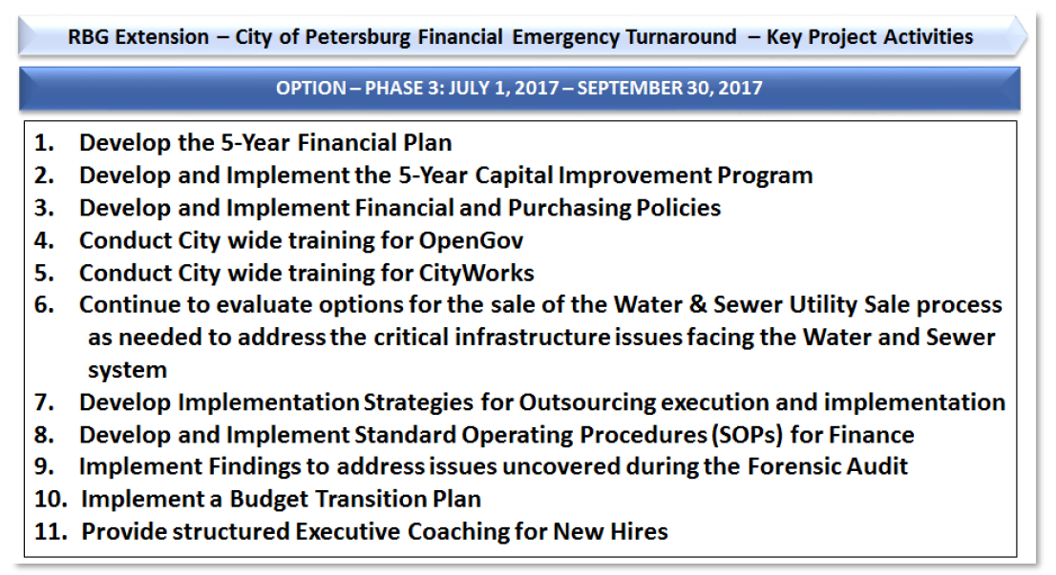
RBG Phase 3 Deliverables – Contracted

Slide 21
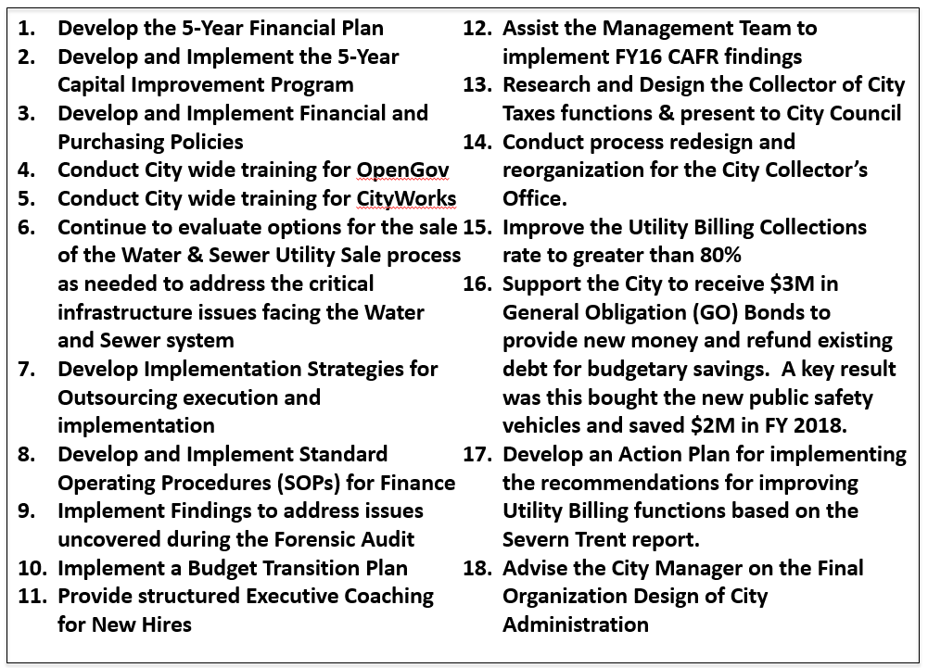
RBG Phase 3 Deliverables – Delivered

Slide 22
5 Year Financial Plan Executive Summary
5 Year Financial Plan
Executive Summary

Slide 23
5 Year Financial Plan: Overview
The purpose of this Five-Year Financial Action Plan is to provide areas of emphasis for the City of Petersburg’s leadership, including the City Council and City management, as they continue to improve the City’s financial condition and build on the work that was performed by the Robert Bobb Group (RBG).
The Five-Year Financial Action Plan is more than a financial forecasting exercise. It showcases the major policy decisions facing the City Council over the next few years. The plan outlines the Top 15 actions the City must take to advance, as well as a financial review of each fund and goals and strategies for each fund to continue the success.

Slide 24
Top 15 Actions The City Must Take
Ensure Diligent Budget Management. If the City leadership manages within the current appropriation for FY 2018, the City could experience as much as a $2.0 million surplus in the General Fund.
Establish a Financial Advisory Board. There are too many authorities, bondholders and elected officials statewide that want to see a continuation of progress and not a retreat to past practices. This includes ensuring bond proceeds are used for the intended purpose.
Continue to improve the City’s bond rating by following recommendations laid out by Standard & Poor’s. While the movement from a ‘negative outlook’ to a ‘stable outlook’ was an incredible achievement in just nine short months, the City leadership should maintain a sense of urgency and diligence to move the City’s bond rating upward.
Achieve and Adhere to Adopted Finance Policies. The City leadership, including the City Council, should monitor the City’s adherence to its adopted financial policies.

Slide 25
Top 15 Actions The City Must Take
Effective Transition to City Collector. At the request of City Council, the RBG has developed a transition plan to move from a City Treasurer-led collections function to a Council-approved City Collector—a circumstance where the collections function is the responsibility of the City Manager.
Improve City-Wide Collection Efforts, including the Utility Fund. Per Council resolution, the Utility Fund must report a collection rate of at least 90 percent by January 2018 or the rate increase approved for FY 2018 is rescinded.
Eliminate the need for Revenue Anticipate Notes (RANs) by increasing cash flow and improving fund balance. Until the City is able to carry enough cash balances to pay its accounts payables in a timely fashion, it will need to rely on RANs.
Pursue Liquidity. Whether it is the sale of City-owned properties, the sale of its excess capacity of water, or privatizing the utility system, the City should continue to pursue one-time revenues that will help to restore the Fund Balance and provide the necessary cash flow to eliminate the need for a RAN and increase the City’s credit rating. The City owns in excess of 300 properties.

Slide 26
Top 15 Actions The City Must Take
Keep Engaged with Regional Partners for Collaboration and Funding Opportunities. A concern that was apparent upon the RBG’s arrival in October 2016 was the City’s failure to participate in regional meetings.
Increase use of Data Analytics for Decision-Making and Invest in Technology Infrastructure. The City did not and currently does not have the analytical power or tools to be able to think more strategically, effectively and efficiently.
Remedy the CAFR Audit Findings; Eliminate the Qualified Opinion on the Utility Fund; and Address the Items Identified in the Forensic Audit. City management needs to actively work the list of findings to reduce the number of findings in the future and eliminate the qualified audit opinion on the Utility Fund.
Working with the contracted Internal Auditor, continue to develop solid financial and business policies, practices and procedures. While the RBG did significant work in this area, particularly related to policy development for financial/budgetary, procurement, Accounts Payable and grant management, continued discipline is needed.

Slide 27
Top 15 Actions The City Must Take
Work to eliminate any outstanding payables and determine path forward for repaying misused urban allocation funds and inappropriate loans made from the Perpetual Care Fund. The City management and City Council should determine the best path forward to repaying the dollars.
Develop a structurally balanced FY 2019 Budget. The largest challenge that will face the City in FY 2019 is addressing continued pay issues, aging infrastructure and a significant 45 percent requested increase to the Petersburg City Schools appropriation.
Continue to invest in City Council training and professional development to ensure the City Council has the right tools to hold its direct reports accountable. The City Council should ensure that it is represented annually at the Virginia Municipal League’s conference and should engage in ongoing professional development activities. The City Council should hold and appropriately schedule annual performance reviews for its direct reports and tie pay increases to performance.

Slide 28
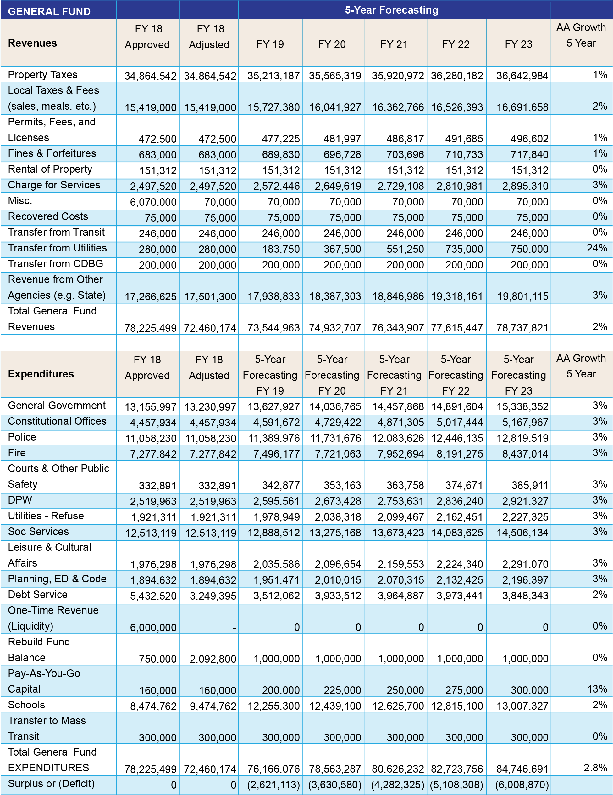
General Fund Forecast
It is critical to Rebuild the Fund Balance. FY 2018 will require diligence and very active management to get there.
See pgs. 16-19 for the Key Assumptions that make up the 5 Year Financial Plan

Slide 29
General Fund: Goals and Strategies
Real Property Tax Goal: Reduce Real Estate Tax Rate to Statewide Average for Cities by 2030
Salary and Benefits Goal: Ensure salaries and benefits remain competitive regionally and statewide at all levels of government and qualified employees are recruited and retained
Fleet Management Goal: Develop a financing plan to replace emergency and non-emergency vehicles to maximize efficiency and provide quality service delivery
School Investment Goal: Invest in the Petersburg City Public Schools and look for opportunities for consolidation of resources
Debt Service Goal: Improve General Obligation rating to investment grade in order to have greater access to the capital markets to fund the City and PCPS capital needs.
Fund Balance Goal: Improve the Funds Balance to the Adopted Policy level of 10 percent of General Fund expenditures and School Fund (net of City’s local transfer)
Risk Reduction Goal 1: Implement and monitor claims to reduce costs to the City. Goal 2: Implement observations and findings from CAFR, Internal Audit reporting and the Forensic Auditor report. Goal 3: Improve working conditions for employees.
See pgs. 20-25 for the General Fund Strategies aligned with these Goals in the 5 Year Financial Plan

Slide 30
Other Funds: Goals and Strategies
SPECIAL REVENUE FUNDS: GOALS AND STRATEGIES
Goal: Adhere to the adopted Grants Processing policy that can be found on p. 155 of the Adopted Budget
STORMWATER FUND: GOALS AND STRATEGIES
Goal: Ensure that the Stormwater Utility adheres to the City’s stormwater management plan and any rules and regulations from the Commonwealth’s Department of Environmental Quality (DEQ)
MASS TRANSIT FUND: GOALS AND STRATEGIES
Goal: Ensure that the level of funding for PAT is understood and consistent with the Commonwealth’s Department of Rail and Public Transportation (DRPT)
See pgs. 26-29 for the General Fund Strategies aligned with these Goals in the 5 Year Financial Plan

Slide 31
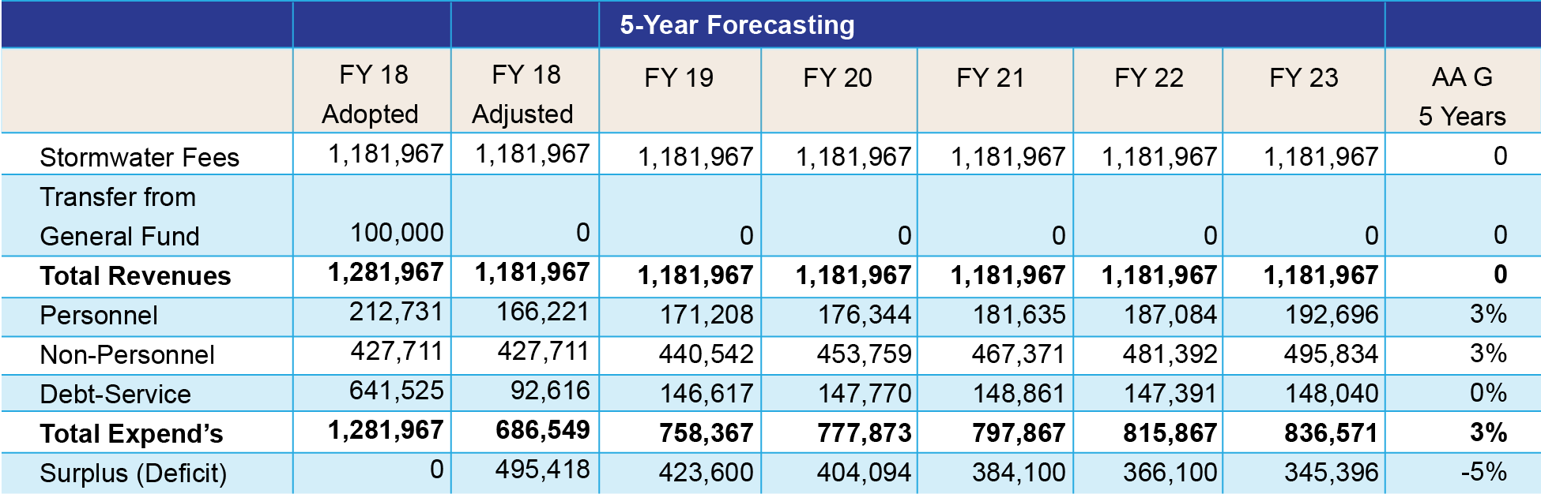
Stormwater Fund Forecast
This transfer was to offset the misallocation of bond funds. This was fixed during the July 2017 refunding and the transfer is no longer required. This action also remedies one of the FY 2016 CAFR audit findings.
See pgs. 16-19 for the Key Assumptions that make up the 5 Year Financial Plan

Slide 32
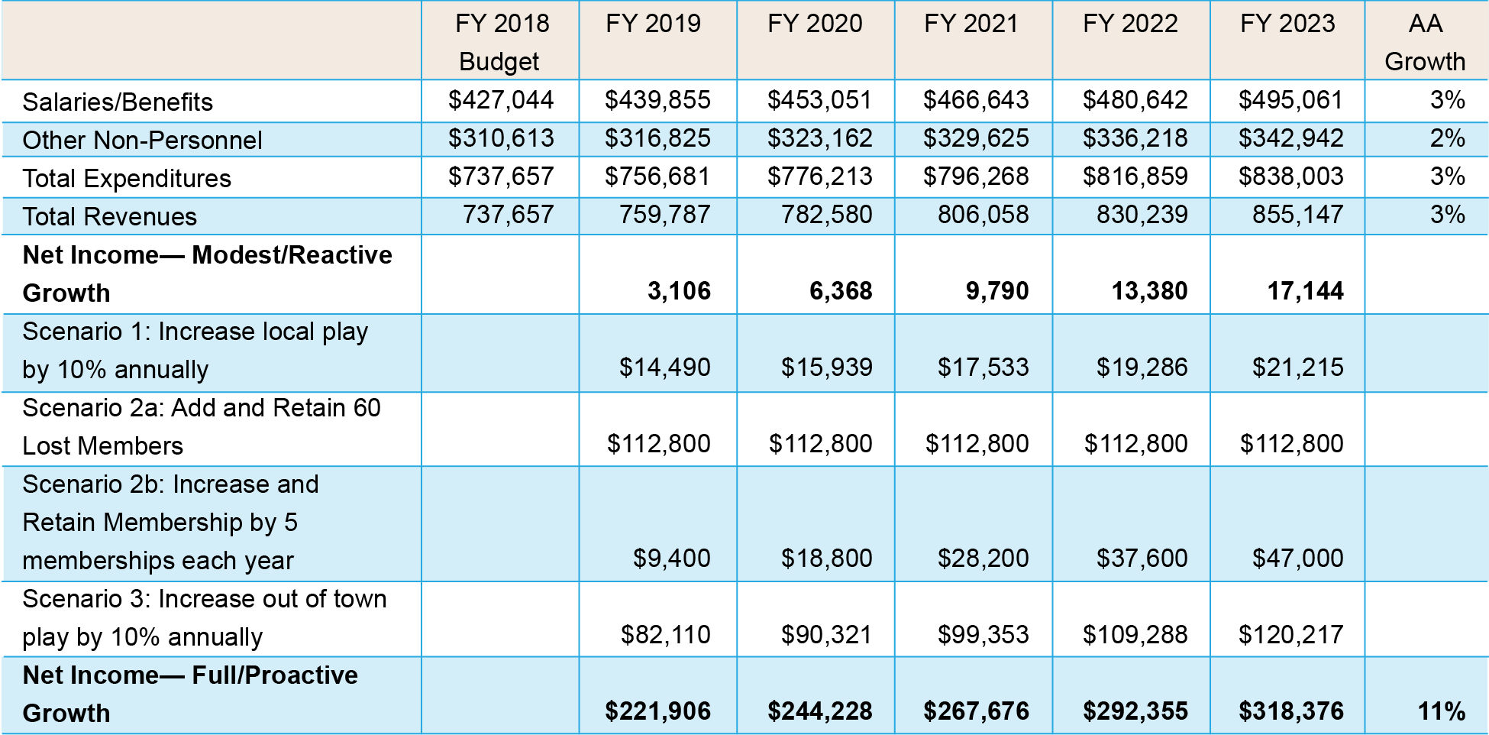
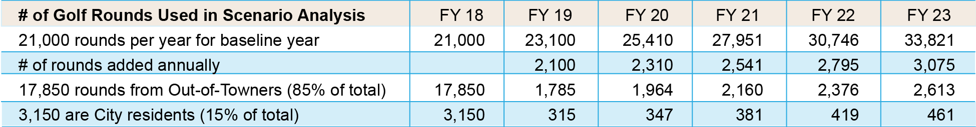
Golf Course Fund Forecast
See pgs. 31-32 for the Key Assumptions that make up the 5 Year Financial Plan

Slide 33
Golf Course Fund: Goals and Strategies
GOLF COURSE FUND: GOALS AND STRATEGIES
Goal: Ensure that the golf course fees cover the cost of the service and are kept competitive with the region so not to reduce usage.
Goal: Create a large enough surplus in the Golf Course Fund so that General Fund cash is not subsidizing the operations in any one month.
Goal: Have a City Council and community goal to promote the success of the golf course, as it is a new facility that was developed and financed from the General Fund
Goal: Continue to explore the feasibility of entering into a public-private partnership, or other mechanism, to eliminate the City from having financial and management oversight of the facility
See pgs. 33-34 for the Golf Course Fund Strategies aligned with these Goals in the 5 Year Financial Plan

Slide 34
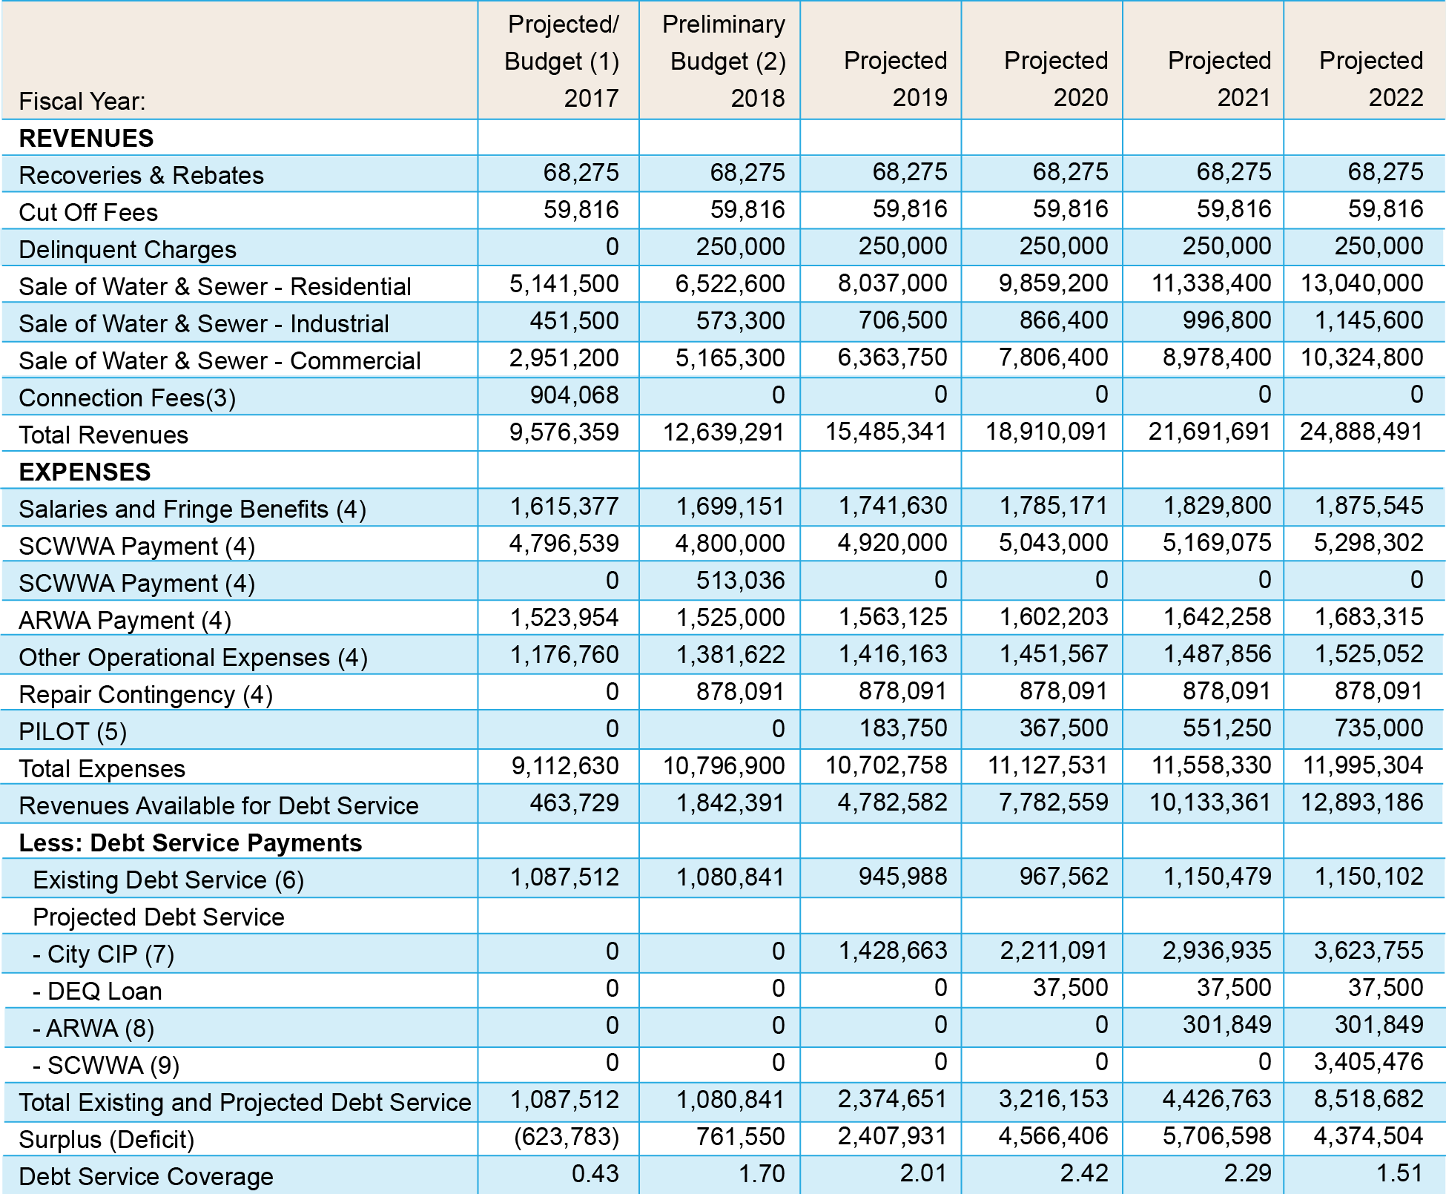
Utility Fund Forecast
See pgs. 36-37 for the Key Assumptions that make up the 5 Year Financial Plan

Slide 35
Utility Fund: Goals and Strategies
UTILITY (Water / Wastewater) FUND: GOALS AND STRATEGIES
Goal: Adhere to the pro forma for the water/wastewater utility.
Goal: Develop a funding strategy for the necessary upgrades to the system
See pgs. 37-38 for the Utility Fund Strategies aligned with these Goals in the 5 Year Financial Plan

Slide 36
Blandford Cemetery: Goals and Strategies
BLANDFORD CEMETERY PERPETUAL CARE FUND: GOALS AND STRATEGIES
Goal: Settle the outstanding “loan” due to the Perpetual Care Fund.
Goal: Ensure that the Perpetual Care Fund is sustainable and can be used to offset the cost of maintenance on the Cemetery
See pgs. 40-41 for the Cemetery Fund Strategies aligned with these Goals in the 5 Year Financial Plan

Slide 37
5 Year Financial Plan – Closing Statement
The Council Committees and the Financial Advisory Board are the organizational structures to provide the executive oversight of the Financial Plan.
Not only does the City Council and City management team need to set an ethical tone as recommended by the Forensic Audit, but it also must also transform its organizational culture that hasn’t been sufficiently accountable in the past.
In addition, the City must change its community’s culture, which has not experienced the consequences of not paying its bills to the City in a timely fashion.
The Appendix references key supporting documents that are on the City’s website or will be added to the City’s website.

Slide 38
5 Year Financial Plan – Closing Statement
APPENDICES
  Standard & Poor’s Credit Rating Report
  City Collector Transition Plan
  38-Point Plan for Remedying the Utility System
  Severn Trent Report
  CAFR Audit Findings
  Forensic Audit Report and Findings
  Letter from VRA about non-compliance
  Utility System Rate Study

Slide 39
Internal Auditor
CliftonLarsonAllen LLP is the new Internal Auditor

Slide 40
Scope of the New Internal Auditor
CliftonLarsonAllen LLP is the new Internal Auditor
They will ensure progress on the implementation of recommendations as well as the monitoring of controls for:
  Comprehensive Annual Financial Report (CAFR) Findings
  Forensic Audit Report Findings
  City Council Adopted Financial Policies
  Other Recommendations Provided In:
    5 Year Financial Plan
    Collector Transition Plan
Council should review and approve its resolution to implement the Citizen Advisory Auditing Committee as sponsored by Councilwoman Wilson-Smith

Slide 41
Scope of the New Internal Auditor
The Internal Auditor will also bring Government Finance Officers Association (GFOA) Best Practices:
“A formal internal audit function is particularly valuable for those activities involving a high degree of risk (e.g., complex accounting systems, contracts with outside parties, a rapidly changing environment).”
“The internal audit function should be established formally by charter, enabling resolution, or other appropriate legal means..”
It is recommended that internal auditors of state and local governments conduct their work in accordance with the professional standards relevant to internal auditing contained in the U.S. General Accounting Office’s publication Government Auditing Standards, including those applicable to the independence of internal auditors..”
Source: http://www.gfoa.org/print/402

Slide 42
Collector Transition Plan
Executive Summary
Collector Transition Plan
Executive Summary

Slide 43
Purpose of this Document
This document provides a 20 Point Transition Plan to guide the redesign of the City’s
Billing & Collection operations.
Background: In July 2017, City Council approved the reinstatement of a City Collector based on Section 3.14 of the City Charter. This action transitions collection functions from the Treasurer’s Office to the chartered City Collector. In August 2017, the City Manager decided to combine Utility Billing with the new City Collector’s scope. This Transition Plan focuses on a consolidated Office of The City Collector and Utility Billing.

Slide 44
Contents
Guiding Principles
Executive Summary of 20 Point Action Plan
RBG Framework for the Redesign
New Billing & Collections Office Organization Chart
Review of New Billing & Collections Operations
  Customer Service Delivery
  Business Processes
  Technology
  Data & Reporting
  Controls & Governance
  Staffing
Appendix
  RBG Restructuring Checklist

Slide 45
Guiding Principles – “Guard Rails”
The City Cannot Retreat: It is critical that the City’s day to day billing, payments and collections activities do not stop or be negatively impacted. Any disruption to billing and collections will recreate the same dire financial scenario as in 2016 when Utility Billing did not occur. Not maintaining the current state minimum level of payment and collections could risk making Payroll and paying vendors.
This Effort Requires Strong Executive Oversight: The Implementation Team must include, in addition to the new Director of Billing & Collections, the City Manager, the Chief Financial Officer, the Procurement Officer, and other staff or consultants as needed.
A fully integrated Cross Functional Team Will Take Time: Utility staff must learn City Tax, Revenue and Collections payments and former Treasurer staff must learn Utility billing. This team will need strong financial controls, policies and procedures. Combining billing, payments and collection operations into one office can incentivize fraudulent behavior without strong controls and management.

Slide 46
Transition Plan Executive Summary
1 of 4
The Transition Plan is based on 20 Action Items detailed in this document.
Create the Implementation Team and Act With Urgency: The revenue scope is $100+ Million from all City funds. This is a “Start Up” business enterprise where URGENCY is a Top Priority. The new City Collector Office can potentially result in a significant increase in revenues.
Establish One Consolidated Office Space for Utility Billing and Treasurer Staff in City Hall: this includes 6 staff and the Director (total 7 FTEs).
Create an Employee Training Plan: The Director must develop a Plan for Employee Training that includes cross training for a fully integrated Billing and Collections Office.
Implement a Staffing Policy: The Director must have a Staffing Policy that manages staff attendance to ensure customer service delivery.
RFP Process for all Delinquent Collections Services: We recommend the City issue a comprehensive RFP for a “One Stop Shop” for all delinquent Collections services by November 15TH.
Note: Per the Comp Board, the Treasurer can keep 2 positions. Our plan assumes the other 2 positions join the Collector Office.

Slide 47
Transition Plan Executive Summary
2 of 4
Start the Real Estate Tax Sale process and cancel the Propel contract. Send the data file to Sands Anderson and kick start the Real Estate Tax Sale process. Per the Propel contract: “The Treasurer agrees to repay all principal amounts unpaid to Propel by the Taxpayer..”
Pursue Delinquent Utility Billing Collections: The City lacks a process for collecting delinquent accounts. AS400 data shows an average monthly ~$200,000 uncollected utility revenue. The FY2016 CAFR reports $1.5M in Utility Accounts Receivable. The City must understand this difference.
Implement the Comprehensive Recommendations from the Severn Trent Report: The Director should implement the recommendations to reforming the Utility Billing office based on the Severn Trent Report.
RFP Process for all Banking Services. Currently, SunTrust provides all banking services for the City. This service should be competed and fees negotiated to ensure the best service to the City.
RFP Process for Security Services. Security system similar to a bank and approved by the Police Department, security personnel onsite.

Slide 48
Transition Plan Executive Summary
3 of 4
Implement a Surge Staffing Plan for Peak Payment Periods: Staff must create a “Surge Staffing Plan” during Peak Payment Periods (e.g., March and June due dates).
Implement Program Management Office (PMO) to manage the entire transition, including a jointly staffed PMO including the Meters Supervisor and the Collector.
Publish a daily “City Cash Balance Report” and the City Collector and Finance Director should review it daily.
Reconfigure the SunTrust Lockbox to reduce errors and manual processes associated today with online bill payment.
Conduct training for all staff (6 Staff and 1 Director) to access data in AS400, write queries and make everyone a “Power User.”

Slide 49
Transition Plan Executive Summary
4 of 4
Report on overall collections monthly to Council including Payments to the City, Collections Remitted, Utility Billings & Collections, delinquent account reporting (what was sent to vendor and what was collected).
RFP Process to replace all manually read meters and all commercial meters. Manage through the Joint Meters & Billing PMO.
Implement Controls on ALL Staff users of AS400.
Develop Business Process Documentation that includes financial policies and Standard Operating Procedures (SOP’s).
RFP Process for Utility Billing Software that includes at a minimum: Ability to run a Run a 90 Day Delinquent Report, Run a Cut Off Report, and view entire customer history – all with 1 Click of a Button

Slide 50
Transition Project Plan: 4 Stages
Intense & Challenging Transition Period Becomes Steady State by May 2018
October 2017
November 2017
December 2017
January 2018
February 2018
March 2018
April 2018
May 2018
#13. Publish a daily “City Cash Balance Report”
#16. Report Overall Collections Monthly to Council
#1. Create the Implementation Team
#12. Implement a Program Management Office
#2. Establish One Office Space
#4. Implement a Staffing Policy
#11. Implement Surge Staffing Plan for Payment Periods
#3. Create an Employee Training Plan
#7. Actively Pursue Delinquent Utility Billing Collections
#8. Implement the Recommendations from Severn Trent
#6. Start the Real Estate Tax Sale process.
#18. Implement Data Entry Controls on AS400 users.
#19. Create Standard Operating Procedures.
#14. Reconfigure the Lockbox with SunTrust
#5. RFP Process for all Delinquent Collections
#15. Conduct staff training to create AS400 Power Users
#9. RFP Process for all Banking Services
#10. RFP Process for all Security services
#17. RFP Process to replace all manually read meters.
#20. RFP Process for Utility Billing Software

Slide 51
RBG Approach
Framework for the Redesign of
Billing & Collections

Slide 52
RBG Framework for the Redesign
It is critical that for each area Policies, Practices & Procedures are well defined
RBG’s Transition Plan for the redesigned office for City Collections is based on 6 key areas:
Customer Service Delivery
Business Processes
Technology
  Service Delivery: focus on how staff serve customers and stakeholders
  Business Processes: focus on how staff and customers manage the money
  Technology: focus on the underlying systems that support the business
Data & Reporting
Controls & Governance
Staffing & Training
  Data & Reporting: focus on data in/out of the systems, and reporting
  Controls & Governance: focus on ensuring financial integrity and compliance
  Staffing: focus on People, their roles and skill sets

Slide 53
Create an Implementation Team
Action Item #1
Create an Implementation Team and Act With Urgency
The Implementation Team includes the Director of Billing & Collections, City Manager, the Chief Financial Officer, the Procurement Officer, and other critical resources (e.g., 3rd parties).
The scope of revenues is $100+ Million from all City funds. This is a “Start Up” business enterprise where URGENCY is a Top Priority. The new City Collector Office can potentially result in a significant increase in revenues.
THERE IS A HIGH RISK OF IMPLEMENTATION FAILURE

Slide 54
Structure for Management Oversight
Action Item #1
City Council
Meets Monthly
Provides Council Oversight & Accountability for results
Executive Management Team
City Manager
Chief Financial Officer
Director of Billing & Collections
Procurement Officer
Dep. City Mgr. Operations
Executive Management Team
Meets Bi-Weekly
Provides Executive Oversight and Accountability for results
PMO Coordinator (Director of Billing & Collections)
Billing & Collections PMO
Meets Weekly
Manages Project Plan
Reports to Executive Management Team
Joint Meters & Billing PMO
Billing & Collections PMO
Director of Billing & Collections
Utility Billing Staff (4)
Treasurer Office Staff (4)
Other Advisor/3rd Party (as needed)
Joint Meters & Billing PMO
IT Director
Director of Billing & Collections
Meters Supervisor
Utilities Director

Slide 55
Structure for Executive Management
Action Item #1
Executive Management Team:
  Provides high-level oversight, direction, and support
  Ensures the PMO executes on the Transition Plan
  Provide resources as needed
Attendees
  City Manager
  Chief Financial Officer
  Director of Billing & Collections
  Procurement Officer
  Dep. City Mgr. Operations
Meets Bi-Weekly

Slide 56
Structure for Billing & Collections PMO
Action Item #1
Billing & Collections PMO:
  Manage Project Plan for Transition
  Manage Reporting to Executive Management Team
  Manage Risk to Implementation
Attendees
  Director of Billing & Collections
  Utility Billing Staff (4)
  Collector Office Staff (4)
  Other Advisor/3rd Party (as needed)
Meets Weekly

Slide 57
Structure for Joint Meters & Billing PMO
Action Item #1
Joint Meters & Billing PMO:
  Manage Project Plan
  Reports to Executive Management Team
  Manage Risk to Implementation
Attendees
  IT Director
  Director of Billing & Collections
  Meters Supervisor
  Utilities Director
Meets Weekly

Slide 58
Finance Org Chart with Collector Office
Aretha R. Ferrell-Benavides
City Manager/ City Collector
Blake Rane
CHIEF FINANCE OFFICER
Finance Director
TBD
Deputy Chief Financial Officer
Robert Floyd
Assistant Finance Director
Budget
TBD
Purchasing Agent
TBD
Budget Analyst/Risk Manager
Lisa Scott
Purchasing Specialist
Eunita Wade
Assistant Purchasing Agent
Gerrit VanVoorhees
Director
INFORMATION TECHNOLOGY
Janet Avelsgard
Computer Systems & Network Manager
Sang Nuygen
Network Support Specialist
Vacant
Data Analyst
Thomas Booker
Help Desk Coordinator
TBD
Director
HUMAN RESOURCES
Vacant
Human Resources Administrator
Kimberly Robinson
Human Resources Administrator
Antoinette Hopkin
Human Resources Technician
Accountant Grants Accountant
Executive Assistant
Terrance Arrington
Director
BILLING & COLLECTIONS
Customer Services Supervisor
Customer Services Representatives
Customer Services Representative
Customer Services Representatives
Customer Services Representative
Customer Services Representatives
Darlene Williams -Powell
Account Clerk I
Accountant Clerk II
Focus Area
Source: Finance Org Chart developed the City Manager presented to Council on 9/5/17

Slide 59
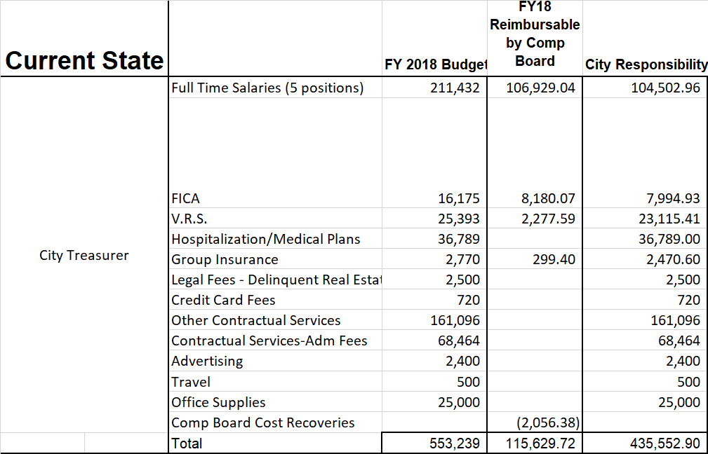
Budget Planning – Treasurer
Current Treasurer Org Chart
(Before Transition)
Treasurer
Staff
Staff
Staff
Staff
The current Treasurer’s includes 4 staff positions in addition to the Treasurer.
Original Treasurer Budget included $435,552.90

Slide 60
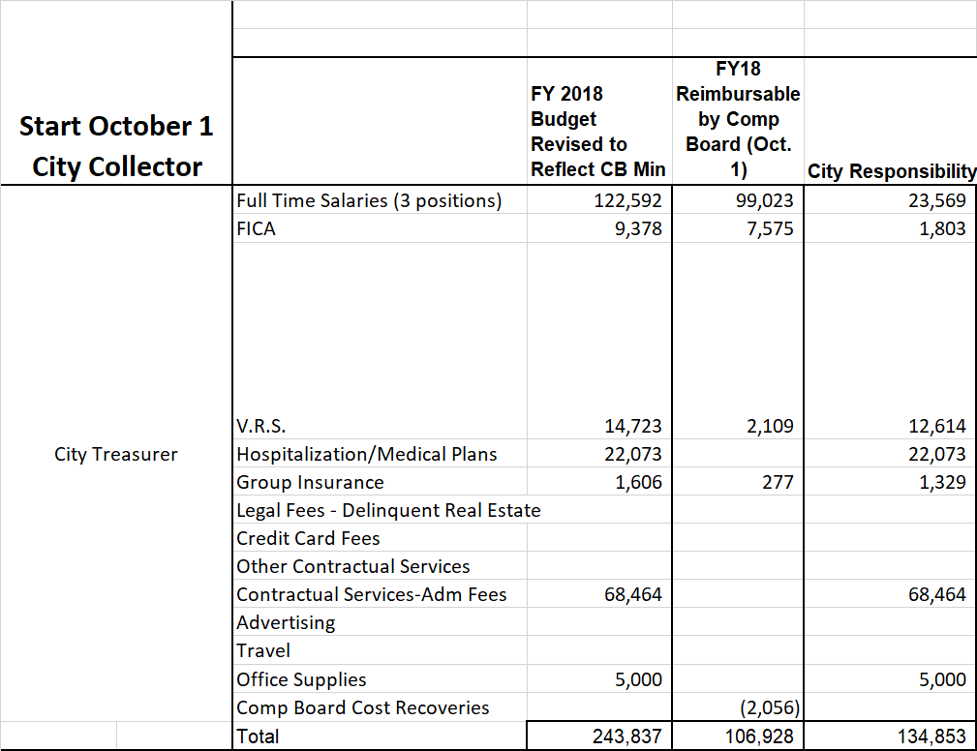
Budget Planning – Treasurer
Treasurer Org Chart
(After Transition)
Treasurer
Staff
Staff
The Treasurer can retain 2 staff positions.
Note: City Administration needs to present to Council a Budget Amendment that defines the budget of the new Collector office based on the reorganization. Finance needs to work with the Comp Board to understand the compensation changes.
The Treasurer’s Budget reduces to $134,853

Slide 61
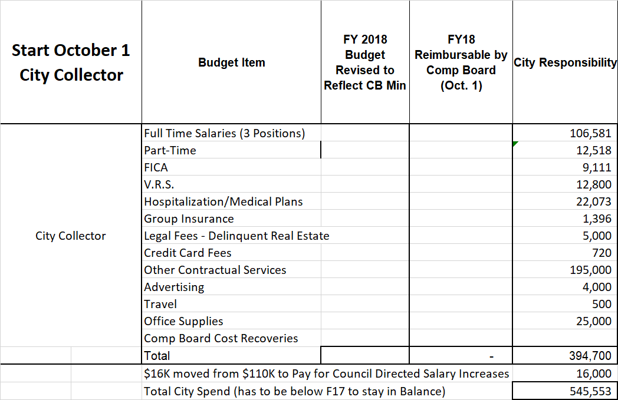
Budget Planning – New Collector
Utility Billing Staff (4) are funded from the Enterprise Fund. Note: A portion of the Director salary may need to come from this fund.
A net new 1 person is included in this office and staff will need to monitor the City-wide budget to ensure that all positions have a source of funding.
There is $394,700 currently available in the City Collector budget to offset the costs of the Transition.
The Budgets for the Treasurer’s Office and the new Collector’s Office should be sufficient to support the Transition.
Note: In the event of other staff changes, the assumed staff budget will change.

Slide 62
One Space for Billing & Collections
Action Item #2
Centralize all 6 staff and Director in City Hall
This includes 4 Utility Billing staff, 2 Treasurer Office staff and the Director (total 7 FTEs).
Elected Treasurer retains 2 staff positions
There are 4 cashier terminals available for payments with connectivity to AS400.
By centralizing all Billing & Collections operations, customers and staff can solve billing related questions and make payments without moving between different buildings.

Slide 63
Recommended Structure for a Consolidated Office of The City Collector
Action Item #2
Aretha R. Ferrell-Benavides
City Manager/ City Collector
Blake Rane
CHIEF FINANCE OFFICER
Finance Director
Office Manager
Former Utility Billing Staff
Former Utility Billing Staff
Former Utility Billing Staff
Former Treasurer Office Staff
Former Utility Billing Staff
Director of Billing & Collections
Former Treasurer Office Staff
This new Org Chart combines 4 Utility Billing staff and 2 Treasurer Office Staff
The Director also reports to the City Manager in her role as City Collector
Need for an Office Manager during Transition (select from current staff)
Note: This model assumes 2 staff will come over from Treasurer Office and 2 will remain in that office. All new Collector Office staff must have cross functional training, and become AS400 “Power Users.”
Office Space Availability
There is space for 4 Tellers and 4 Desks in City Hall to use for both Collections and Utility Billing.

Slide 64
What Will the New Office Look Like?
Action Item #2
The new Billing and Collections Office will combine 4 staff from Utility Billing with 2 staff from the Treasurer’s Office. Total 6 staff including 1 director.
The scope of work for the new office will combine:
  Treasurer cashier activities for all revenues and taxes
  Treasurer collection activities for all revenues and taxes
  Utility Billing activities for all accounts (residential and commercial)
  Utility Collections activities for all accounts (residential and commercial)

Slide 65
Need for Cross Training for Staff
Action Item #3
The Director must develop a Plan for Employee Training that includes cross training for a fully integrated Billing and Collections Office
It is Critical for the Director to cross train all staff across all Billing and Treasurer’s functions
  Cashiering, AS400 data entry, Lockbox
  Utility Bills, 90 Day Delinquencies, Cut Offs
  Customer Engagement
CAUTION: A realistic Training Plan that includes BAI resources is critical to accomplish this Action Item.

Slide 66
Need for Staffing Policy
Action Item #4
We identified a need for a Staffing Policy that ensures office “power users” are present in the office during business hours, or back filled with advance notice
“Power users” refer to key staff in Utility Billing and the Treasurer’s Office who can pull data from AS400, query customer accounts and manage data updates in the system
Staffing and Attendance are within the domain of the Human Resources department so RBG will defer to HR to provide this policy

Slide 67
Critical 3rd Party Services – One RFP
Action Item #5
Guiding Principles for RFP Development
Strong recommendation to re-compete the current contracts for performance based contracts
Robust emphasis on data reporting
Analytics
Key Performance Indicators (KPI’s)
Technology driven
We recommend the City issue one comprehensive RFP for a “One Stop Shop” for all Collections services
The RFP should include EVERY area in which revenues are earned by the City including (e.g., Meals Tax, Business Taxes, Business Licenses, Hotel Occupancy Taxes, etc.)
The City should issue an RFP for any critical 3rd party services By November 15th

Slide 68
Critical 3rd Party Services - Treasurer
Action Item #6
Send the Data File to Sands Anderson to start the Real Estate Tax Sale process. Cancel the Propel contract immediately. Per the Propel contract: “The Treasurer agrees to repay all principal amounts unpaid to Propel by the Taxpayer..”
TACS: signed December 2015, TACS provides collections services on delinquent accounts; gets paid 20% of any collections made to the City (TACS gets paid at collections)
Propel: signed December 2015, Propel provides loans (up to 14% interest) to delinquent taxpayers. Note: per their contract with the Treasurer, the City must repay any delinquent loans IN FULL to Propel so Propel is not at risk and also not incentivized to seek repayment
Sands Anderson: conducts real estate auctions after the appropriate legal waiting period based on a data file sent from. Action: send the data file to Sands Anderson to start the tax sale process for accounts past the normal TACS collections process.
The City should issue an RFP for any critical 3rd party services By November 15th

Slide 69
Critical 3rd Party Services - Treasurer
Action Item #6
These contracts were signed without competition and we strong recommend they are re-competed.
The same firms may offer a better arrangement with a more rigorous procurement process and that includes Sands Anderson.
Finally, managing one comprehensive vendor when possible is better than coordination with several.
The City should issue an RFP for any critical 3rd party services By November 15th

Slide 70
Critical 3rd Party Services – Utility
Action Item #7
Actively Pursue Delinquent Utility Billing Collections: The City does not currently have a process for collecting delinquent Utility accounts.
Utility Billing AS400 data shows on average monthly ~$200,000 in uncollected utility revenue owed by customers.
The FY2016 CAFR reports $1.5M in Utility Accounts Receivable. The City must understand this difference.
Include within scope of comprehensive RFP for Collections
The City should issue an RFP for any critical 3rd party services by November 15th
Source: Utility Billing Deep Dive conducted with Janell Sinclair on 9/7/17

Slide 71
~$200,000 in Uncollected Utility Bills
Action Item #7
Monthly Average of ~$200,000 Delinquent Utility Bills
June 2017
0 delinquent statements
27 “cut offs”
25 “turn ons”
$22,223.02 received
July 2017 (10%)
250 delinquent statements
50 “cut offs”
23 “turn ons”
$28,694.55 received
501 Fund (Utility Fund)
August 2017 (16%)
369 delinquent statements
157 “cut offs”
38 “turn ons”
$47,354.65 received
Total Delinquent
Due in August 2017: $297,089.23
Source: Utility Billing Deep Dive conducted with Janell Sinclair on 9/7/17

Slide 72
Critical 3rd Party Services – Utility
Action Item #8
Key Recommendation: The Director should implement the recommendations to reforming the Utility Billing office based on the Severn Trent Report.
RBG presented its Action Plan for implementing the Severn Trent report recommendations to Council during its July 31, 2017 presentation. Contained on pages 32-43, we presented a comprehensive set of actions to address each of the report’s recommendations.
The key areas of focus include ensuring each staff member is a “power user” of AS400 (e.g., can run multiple types of data queries and respond to customers), business processes for billing, delinquent accounts, cut offs and technologies for simplifying manual spreadsheet work.
The City should issue an RFP for any critical 3rd party services by November 15th
Source: Utility Billing Deep Dive conducted with Janell Sinclair on 9/7/17

Slide 73
Critical 3rd Party Services – Banking
Action Item #9
Key Recommendation: Issue RFP for all Banking Services. Currently, SunTrust is the City’s banker and responsible for the Lockbox which was poorly implemented (i.e., data configuration does not account for customer only bill payment)
SunTrust is the current credit card processor. The RFP should include in its scope a renegotiation of each merchant credit card (e.g., Mastercard, Visa, American Express, Discover) and recommend which credit cards are best for the taxpayer.
Areas to explore: can residents pay at any SunTrust branch in the metro area? Can payment kiosks be placed in the Transit station, Walmart or other areas of major foot traffic?
The City should issue an RFP for any critical 3rd party services By November 15th

Slide 74
Critical 3rd Party Services – Security
Action Item #10
Key Recommendation: Issue RFP for comprehensive suite of security services that includes:
  Armed transportation for daily cash deposits (currently done by City staff)
  Camera system similar to a bank
  Security personnel onsite at the City Collector’s Office (especially during peak payment periods)
The security system should be reviewed and approved by the Petersburg Police Department.
The City should issue an RFP for any critical 3rd party services By November 15th

Slide 75
Today Staff Make Bank Deposits
Action Item #10
Recommendation: Contract a security service (e.g., Dunbar) to deposit cash
Treasurer staff personally drive locked bags of daily cash deposits SunTrust Bank in Colonial Heights
Brinks Service was cancelled in March 2016
The Daily Process:
  Transit delivers daily revenues
  Staff prepares previous day’s cash
  staff take cash in locked bags to the City’s corporate account in Sun Trust located in Colonial Heights
  SunTrust counts, processes and deposits
Source: Treasurer’s Office Deep Dive conducted 9/12/17 – 9/13/17

Slide 76
Service Delivery
Customer Service Delivery

Slide 77
Create a Surge Staffing Plan
Action Item #11
Key Recommendation: Staff must create a “Surge Staffing Plan” during Peak Payment Periods (e.g., March and June due dates)
Customers can pay using the following payment methods:
Cash, Check, Credit Cards, Lockbox
  SunTrust is the credit card processor
  PayPal is an option
Note: Problem of incorrect E-check; no system of kicking back wrong routing numbers
Per staff, many customers pay in person by money order (if do not have bank accounts), or they want paper receipts
March Payment Crunch: in March first half of Personal Property (end of Feb & June 10th) & Real Estate (Real Estate Quarterly: Sept/Dec/Mar/June) & Water Bills Every Month
Decals for Cars: get by June 10th (2nd payment for Personal Property); most will pay 8th, 9th, 10th
Customer Payment Schedules
Customer Payment Methods
Source: Treasurer’s Office Deep Dive conducted 9/12/17 – 9/13/17

Slide 78
Create a Program Management Office
Action Item #12
Key Recommendation: The Director should create a Program Management Office (PMO) to centralize and manage the entire suite of services offered.
Utilize PMO software such Microsoft Project Server or Clarizen
Utilize structured project plans that includes specific start dates and end dates, assigns specific owners
Manage all work, staffing, payment, billing, collections schedules through this single system.
Hold Staff Accountable for their Work
Source: Treasurer’s Office Deep Dive conducted 9/12/17 – 9/13/17

Slide 79
Business Processes
Business Processes

Slide 80
Daily Cash Processes
Action Item #13
Key Recommendation: Staff should create a daily “City Cash Balance Report” and the City Collector and Finance Director should review it daily
The report should include accruals, daily counts, reporting, methodologies, cash security policies
Implement the following control: Monitor and Report on employee data entry for any modifications to AS400 data (e.g., recording and updating cash payments)
Background:
  SunTrust in Petersburg cannot take corporate accounts; need to go to Colonial Heights branch
  SunTrust selected by RFP process (they were only bid)
  Average City Balance varies daily: $5,000 to $35,000
  Average Daily Balance for Transit: ~$1,100 (mostly coins); has Locked Bag #
Source: Treasurer’s Office Deep Dive conducted 9/12/17 – 9/13/17

Slide 81
Reconfigure the Lockbox with SunTrust
Action Item #14
The Lockbox Implementation did not integrate Online Bill Payment
Lockbox:
  Implementation was rushed and did not include data integration for customer online bill pay (Lockbox consists of a scanner designed for preset bill forms, e.g., customer account number in a fixed location)
  Online bill pay systems mail checks to Lockbox, which get sent to exclusion file, and must be posted manually
  Lockbox only works with bar codes (for Water Bill; on bottom left) and account numbers (for real estate and personal property)
  Recommendation: Reconfigure the Lockbox with SunTrust to incorporate Customer online bill pay from any bank
Source: Treasurer’s Office Deep Dive conducted 9/12/17 – 9/13/17

Slide 82
Technology
Technology

Slide 83
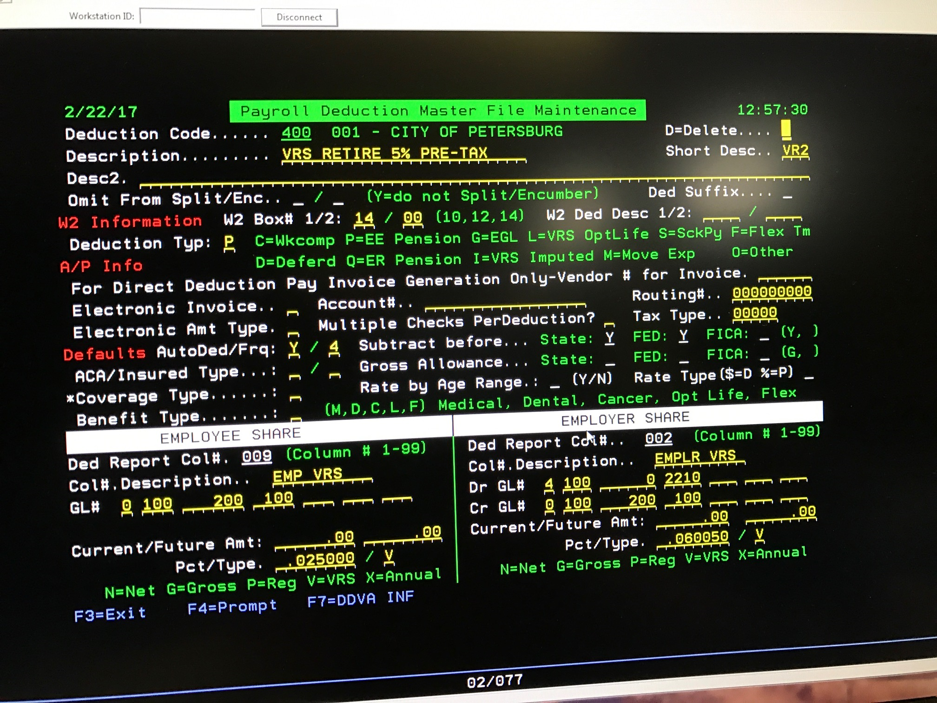
Only a few staff can access AS400 data
Action Item #15
Screenshot of Payroll Module (Utility Billing screenshot unavailable)
Source: HR/Payroll Deep Dive conducted on 2/22/17

Slide 84
Make All Staff AS400 Power Users
Action Item #15
There are 2-3 Power Users of AS400 in the new office with 9 staff
Immediately conduct training for all staff (6 Staff and 1 Director) to access data in AS400, write queries and view customer accounts
Make all 6 staff and the new Director a “Power User” so each employee can:
  field customer inquiries regarding Utility Billing and accounts
  manage data entry for payments directly into AS400
  manage updates based on collections remittances
Source: Treasurer’s Office Deep Dive conducted 9/12/17 – 9/13/17

Slide 85
Data & Reporting
Data & Reporting

Slide 86
Report to Council Monthly
Action Item #16
Key Recommendation: Report Billing and Collections Activities, Improvements and Revenues Monthly
The new Billing and Collections Office is a $100+ million “start up business” and the City has a significant opportunity to increase revenues
Council should monitor progress of this Office through monthly reporting
Monthly reporting should include:
  Utility Billings Generated
  Utility Revenue Earned
  Taxes Paid
  Collections Remitted to City
  Payments made to 3rd parties (Banking, Security, Collection Agencies)
  Utility Billing Process Improvements
Source: Treasurer’s Office Deep Dive conducted 9/12/17 – 9/13/17

Slide 87
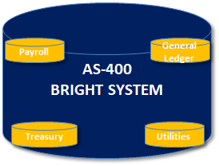
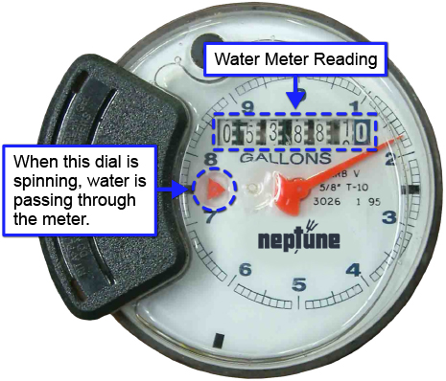


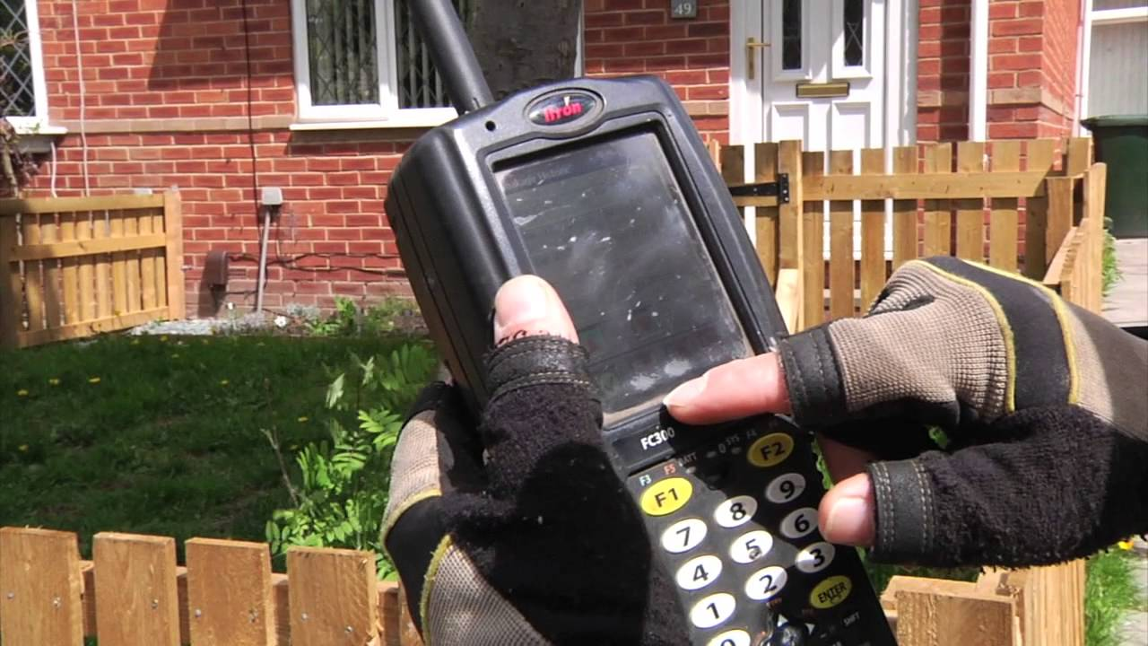
Issue an RFP to replace all manually read meters and all commercial meters
Action Item #17
This Project reports to the Joint Meters & Billing PMO (see PMO Structure)
With Itron ERTs, meter data is read by ~4 vehicles on “drive by” certain accounts with ERTs)
Without Itron ERTs, meters are read manually
IT then uploads to AS400
Utility Generates Bills
~1000 accounts with no ERTs require manual reads => this is a significant cause of errors
The Itron ERT (Encoder Receiver Transmitter) enables automatic meter reading by sending data from utility meters over a short range so a utility vehicle can collect meter data without a worker physically inspecting each meter.

Slide 88
Controls & Governance
Controls & Governance

Slide 89
Monitor & Report on all Data Changes
Action Item #18
Key Recommendation: Implement Controls on ALL Staff users of AS400.
Control Needed to monitor unauthorized changes to customer accounts
The Director should ensure all staff understand policies and procedures for ensuring customer data and information security
This will help ensure financial data is accurate and compliance with federal and state regulations
No Documented Controls for Data Entry or Data Changes were observed
CAUTION: We have a strong concern with someone who would have access and training to both billing and collections. The Forensic Audit documented fraudulent behavior by the Treasurer who had access to petty cash and AS400 data entry. THIS REQUIRES A VERY STRICT CONTROL.
Source: Treasurer’s Office Deep Dive conducted 9/12/17 – 9/13/17

Slide 90
Implement Detailed
Policies & Procedures
Action Item #19
Each of the 6 Areas should have detailed Policies and Standard Operating Procedures
Key Recommendation: Create and issue each current any new employee a binder of Standard Operating Procedures (SOP’s).
Employee Training
  There is training (2 days) by Treasurer’s Association of Virginia
  Only Collectors have gone to the Training
Standard Operating Procedures
  Write Standard Operating Procedures (SOP’s) for each of the 6 areas in the framework
  Any new employee should enter the Office and receive a binder of documentation
Source: Treasurer’s Office Deep Dive conducted 9/12/17 – 9/13/17

Slide 91
Staffing
Staffing

Slide 92
Remove Manual Processes used by Staff
Action Item #20
People, Process, Technology
The new Office will have a combined staff of 6 employees (4 from Utility and 2 from the previous Treasurer’s Office) and 1 Director
The team will be cross functional: to manage tasks in either Utility or Treasurer’s Office
All staff will become “Power Users” of AS400
All staff will follow strict controls for data entry
By combing Utility Billing and overall Payment and Collection operations, the City will realize greater process efficiency and revenues

Slide 93
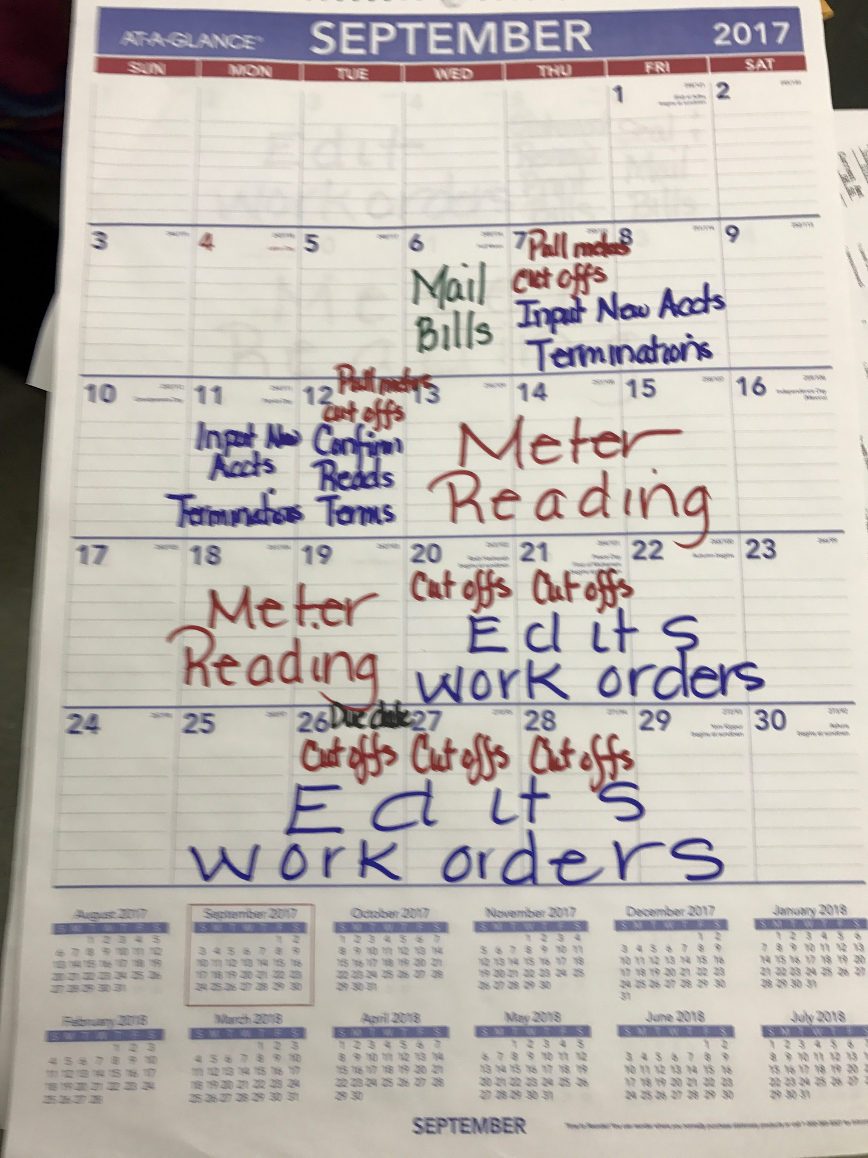
Utility Billing – Manual Business Processes
Action Item #20
The monthly billing and meter reading schedule is paper based and manual
Actual dates to mail bills, conduct meter readings and edit work orders vary month to month
Cut off reports are developed manually using spreadsheets downloaded from AS400
Source: Utility Billing Deep Dive conducted on 9/7/17

Slide 94
Urgent Need for Utility Technology
Action Item #20
According to Severn Trent’s Final Report to the City:
  Reports out of the system are not adequate to provide management with a complete overview. They provide limited customer information by transaction. For example:
    The detailed general ledger transaction report list does not contain any unique customer information. If there is a large adjustment in error, you can only see the source, date of transaction and amount.
  Access to specific reports are not properly identified to provide the proper oversight.
  All employees do not have access to canned reports within their scope of work built in the system. The current setup requires staff to requests reports from IT personnel on a regular basis just to perform daily tasks. The staff does not appear to be equipped with the necessary tools to perform their daily jobs because of programming and setup limitations of the billing system.
Source: Severn Trent Final Report, “Customer Service & Billing Operation Final Assessment,” July 2017.

Slide 95
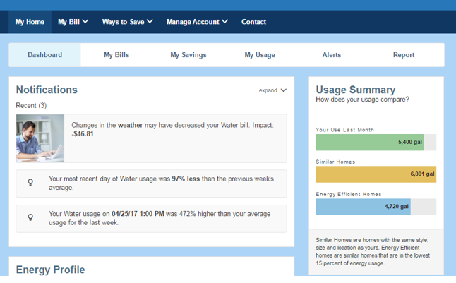
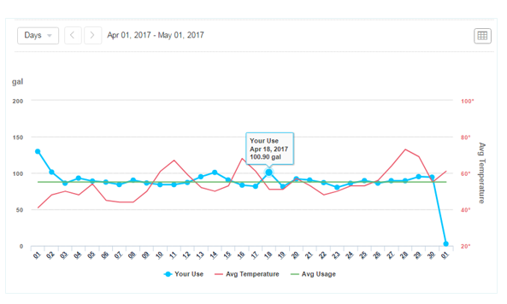
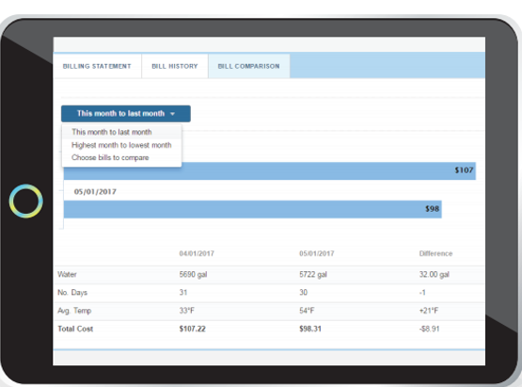
Issue an RFP for Utility Billing Software
Action Item #20
Both Utility Billing staff and customers need easier and faster data visibility to:
  Run a 90 Day Delinquent Report with 1 Click of a Button
  Run a Cut Off Report with 1 Click of a Button
  View Entire Client History with 1 Click of a Button
The City should issue an RFP for any critical 3rd party services by November 15th

Slide 96
RBG Accomplishments
Summary of RBG
Accomplishments

Slide 97
RBG Accomplishments
Balanced the FY17 Budget for the first time since 2009
Restored the 10% Pay Cut in FY17
DSS State Reimbursement
  RBG requested and received $625,000 back to the City’s Department of Social Services.
Settled SCWA Lawsuit
  $1.3M settlement with South Central Wastewater Authority
Positioned the City to secure $6.5 Revenue Anticipation Note (RAN)
Ensured City Payroll in November – December 2016
Council approved reducing the rehab tax credit from 10 years to 5 years.

Slide 98
RBG Accomplishments
Sold 70+ Surplus Physical Assets for Auction (e.g., unused police and fire vehicles)
Conducted Real Estate Showcase to streamline sale of eligible city owned real estate properties
Completed a nationwide Executive Search to find permanent City Manager, Director of Finance, Police Chief, Fire Chief
Forensic Audit completed report due by end September 2017 (RFP received 6 proposals from nationwide)
Implemented OpenGov to build the FY18 Budget, and establish monthly financial reporting

Slide 99
RBG Accomplishments
Sold the Petersburg Generals baseball team for $100K
Created Standing Committees to tackle key issues
  Public Safety
  Fiscal Policy
  Education
Implemented CityWorks for Utilities Department to track work orders, repairs, cost of repairs, staffing
All authorities were made whole by the end of June 2017. VRS and SCWWA will be paid off December 2017 and FY 2019, respectively. The remaining two have been appropriated in the FY 18 budget.

Slide 100
RBG Accomplishments
$8M for funding for parking garage. The City did not have to come up with a previously required $3M match.
DEQ Grant for Water Utility funding: DEQ waived $200,000, and turned into zero interest grant. Balance of $550K DEQ grant is a zero interest loan. We helped the City achieve another zero interest loan of $2 Million.
Resolved Impasse to Receive Future Fire Funds of $280,000
Utility Collections Rate improved from 70% to an average of 86%

Slide 101
RBG Accomplishments
Landfill revenues increased by an additional $30K
Created a new Contract for Internal Audit Services with a nationally recognized firm CliftonLarsonAllen
Utility Rate Increases have now put the City on sound footing for revenue stream to meet current needs
Established a $500K reserve for unforeseen utility repairs
Successfully enabled funding for Public Safety Vehicles

Slide 102
RBG Accomplishments
VDOT 2040 Transportation Plan initially had no projects for Petersburg. Two (2) projects are now included: VSU Gateway and Collier Yard Access.
Reduced Employee head count within the City Manager’s scope to enable a balanced FY18 Budget
Avoided an extra $300K in healthcare costs by implementing new health care plans in FY18
Helped the City secure a 2017 – 2018 Revenue Anticipation Note (RAN) with a rate of 3% and 50% fees reduction

Slide 103
Technology Framework for the City
Technology Framework for the City

Slide 104
The Problem With AS400
Tribal Knowledge: only a few City staff are power users, and most of them will retire in 3 years.
Reporting: data is extracted out of AS400 as a spreadsheet; analysis takes place in spreadsheets instead of software
End of Life System: BAI experts are retiring and the community of users gets smaller annually
The City will eventually need to replace AS400 soon. This document defines a target state architecture for City technology and a plan to get there.

Slide 105


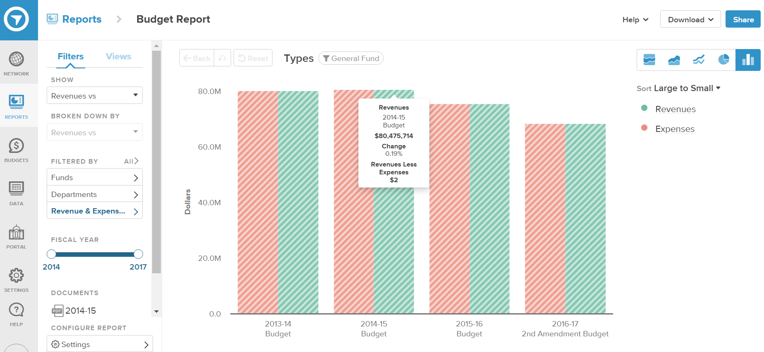

What the Technology Architecture
Looks Like Today
Current State: Patchwork of Connected Systems
OpenGov provides financial data reporting based on AS-400 Chart of Accounts. The City built its FY18 Budget in OpenGov. City will automate integration between AS-400 and OpenGov by 9/30/17.
Cityworks manages repairs, cost of repairs and staff work assignments and utilizes the City’s GIS investment built by Timmons. Scope includes Facilities, Engineering, Utilities & Street.
Key Piece Remaining is $10,000 Integration OpenGov and CityWorks Project and Service Request Fund Code Data pushed from OpenGov to CityWorks
Utilities will have CityWorks for all work and repairs analytics by 9/30/17
AS-400
BRIGHT SYSTEM
GIS CITY ASSET
MANAGEMENT
Payroll
General Ledger
OpenGov tools includes CAFR, Monthly Reporting and Budget Book Tools
Treasury
Utilities
The City invested in GIS buildout by Timmons since 2014. The GIS system is a valuable data repository that can be used by Facilities, Utilities & Engineering. It can also be used to map Police and Fire incident data.
BAI is the financial system of record for the City and manages all City financial data and reporting. It includes the General Ledger, Payroll, Treasury, Utilities. Bright.net is a BAI web interface employees can use to access paystubs and general financial information.

Slide 106


What is the Leading Practice?
Leading Practice for State and Local Governments Today is:
Moving business applications for General Ledger, Payroll, Treasury, Utilities and other critical applications to a cloud based architecture.
Designing Technology Architecture with a customer service approach: One Click of a Button. Payments, reports, data queries. An Approach that prioritizes Simple, Fast, Easy.
Customers should have greater smartphone access: either mobile friendly (you can easily view City websites) or app based (reading your Utility Bill at least, pay bills, view usage/consumption).
EXAMPLE:
Netflix has a huge amount of data and hosts their entire streaming service on Amazon Web Services
EXAMPLE:
Uber mastered the concept of getting transportation with “One Click of a Button.”

Slide 107
Target State: 21st Century Ecosystem
A New Technology Platform

Slide 108
The Need for a New Technology Ecosystem
Building a 21st Century Technology Ecosystem Will Improve Accountability
A return to past financial practices and management is a guaranteed road back to another fiscal crisis for the City. RBG emphasizes the need for a paradigm shift towards data based accountability and decision making.
Cities today are moving to cloud based technologies that make customer engagement easier, that makes bill payment easier, and that makes transparency and reporting easier.
RBG believes the technology focus for City leaders should be on building an “ecosystem:” utilizing a cloud based architecture, in which Financial systems, the GIS system, and other department tools seamlessly share data, staff and customers can access data with “One Click of a Button,” and data reporting is fast and simple.

Slide 109
Advantages to Moving to the Cloud
Agility: Cloud systems make it easier to change business applications as business needs change. The City should not be held “hostage” to a single vendor and forced to pay escalating annual maintenance costs.
Security: Cloud systems are on the hook to ensure the City’s data and applications are safe from loss of data 24x7x365.
Reliability: Cloud systems can save data onto multiple servers. If a single server goes down due to a power outage or other issue, the data is available on another server.

Slide 110
Challenges to Moving to the Cloud
Adopting New Technologies– Government agencies have ingrained cultures that are slow to change. This shift from locally-based servers to the cloud can be slow and tedious for this reason.
Technical Know How- Cloud platforms require specialized knowledge to administer. Many government agencies lack the necessary experts to oversee a migration to the cloud.
Can Be Expensive: Migration to the cloud can involve expensive initial costs for project planning and set up costs. Project funding should anticipate higher start up costs that then reduce during steady state operations.
Build
Transform
Run

Slide 111
Target State Architecture for the City
Cloud Based Infrastructure with SaaS based modules
All of the City’s Data Should be easy to work with.
Target State Technology Architecture is a cloud-based platform that aggregates data from the City’s two primary databases (AS400 and GIS).
The City should have intuitive applications that are easy to use and quick to implement.
This will mean less reliance on IT resources, more customer satisfaction, service reliability, quality and operational efficiency

Slide 112
How To Realize This Vision: Project Plan
Project Plan

Slide 113
Project Plan
STAGE 1
STAGE 2
STAGE 3
October 2017
November 2017
December 2017
January 2018
February 2018
March 2018
Weekly Reporting on Program Status
Identify the Technology Transformation Team
Implement a Program Management Office
RFP Process for Vendor Services
Vendor Design Process
Vendor Build Process
Vendor Transition to New System
Vendor Hosting of New System
Staff Training on the New Technology
Development and Implement Policies and Standard Operating Procedures
Change Management Occurs From Project Start Until Steady State “Run” Mode

Slide 114
Technology Architecture – Target State
Transition State: Some Systems in the Cloud
STAGE 1
Phased Transition from AS-400 to the cloud. Security, risk and infrastructure requirements are managed by the cloud hosting provider.
FINANCIAL SYSTEM IN THE CLOUD
AS-400
BRIGHT SYSTEM
GIS CITY ASSET
MANAGEMENT
AS-400 is the financial system of record for the City. It is responsible for General Ledger, Payroll, Treasure, Utilities.
100% Transition to Cloud Infrastructure. This means off site hosting of all finance related systems. The advantage
OCTOBER 2017
NOVEMBER 2017

Slide 115
AS-400 Target State: Cloud Based Infrastructure with SaaS based modules
Target State: All Systems in the Cloud
STAGE 2
FINANCIAL SYSTEM DATABASE HOSTED “IN THE CLOUD”
(e.g., Amazon Web Services )
Assumptions: Each module in AS-400 can be migrated to a SaaS based system that can interface via API to the cloud based database.
AS-400
BRIGHT SYSTEM
GIS CITY ASSET
MANAGEMENT
Payroll
General Ledger
Treasury
Utilities
AS-400 is the financial system of record for the City. It is responsible for General Ledger, Payroll, Treasure, Utilities.
100% Transition to Cloud Infrastructure. This means off site hosting of all finance related systems.
Phased Transition from AS-400 to the cloud. Security, risk and infrastructure requirements are managed by the cloud hosting provider.
DECEMBER 2017
JANUARY 2017

Slide 116




Flexible Architecture: “System of Systems”
Target State: All Systems in the Cloud
STAGE 3
Business & Customer User Access Layer: Dashboard for Reporting, Data Analytics Interface
Data Transformation Layer: Individual Application Data is extracted,
transformed and loaded in this layer
Controls & Governance System
Cloud Hosted Infrastructure
(e.g., Amazon Web Services )
Treasury
General Ledger
GIS (hosted by Timmons)
Utilities
Payroll
Audit & Compliance System
Mobile Applications for Customers to Pay Bills, Analyze Utility Consumption, Create a Service Ticket
FEBRUARY 2018
MARCH 2018

Slide 117
Target State: 21st Century Ecosystem
The architecture to replace AS400 is a system of systems to avoid dependency on a single vendor. Single vendor would customize and then manage creating a similar AS400 situation years from now. The "system of systems" model is based in the cloud, has no critical dependency on a vendor, but would need a managed hosting service.
Target State: system of systems plugged together using APIs, with a unifying data transformation layer that pulls from all the systems and allows Dashboard reporting.
Advantage: as processes mature, as the business evolves, they can add or remove financial applications, GIS applications, Police/Fire applications
The Dashboard Level is the Business User and the Customer Level. They can view data, slice and dice, run analytics, etc., but never interact with the "Production" Data level (the guts of the systems).
The new Technology Ecosystem will usher in a new age of transparency and accountability increasing access to all staff and customers.

Slide 118
Issue an RFP for a new System
Key Recommendation
Invest in Technology Infrastructure. While the City’s AS-400 (or BAI) system is functional, it is not user friendly and impedes the City’s ability to analyze key functional areas like billing and collections.
The City, once it stabilizes its staffing under the portfolio of the Chief Financial Officer, should pursue the use of a new financial system.
However, in the interim, continued exploration of platforms such as OpenGov that can ease in the collection and dissemination of data from the mainframe system is necessary and should continue.

Slide 119
Opportunities for the City
Opportunities for the City

Slide 120
Future Opportunities for Immediate Focus
VSU Gateway
Parking garage
Dominion Ops Center
Each is a multi-million opportunity where we are tapping grants or private contributions to do something important for the city.
Each one requires a driver that will push the project to completion.
None require significant city tax dollars.

Slide 121
Closing Statement
Closing Statement

Slide 122
What Needs to Happen Next
ACT With Urgency: Don't take the foot off the gas pedal, keep driving and building to a future state where City has a strong Fund Balance, sound financial policies and controls and sound billing and collections processes
ACT Because Failure is Not an Option: the residents, the City's Youth, the Region, the State...depend on you to sustain the improvements we have made
ACT so that Financial Operations Remain Stable:
  Develop a Structurally Balanced Budget for FY 2019
  Implement Standard Operating Procedures
  Continue to maintain stable financial operations to maintain the City’s Bond Rating
Petersburg has been alive for 300+ years and it will continue. Show the region and the state that the City, despite its high poverty, and the past financial troubles, it can grow and be a City on a Hill.

Slide 123
Transparency
All RBG presentations are available on the City’s website:
http://www.petersburgva.gov/index.aspx?NID=846
The following reports must be added to the City’s website:
Standard & Poor’s July 2017 Credit Rating Report
City Collector Transition Plan
38 Point Action Plan for Remedying the Utility System
Severn Trent Final Report on Utility Billing
CAFR Audit Findings & Recommendations for Remediation
Forensic Audit Report and Findings: http://www.petersburgva.gov/DocumentCenter/View/2882
Letter from VRA about non-compliance
Utility System Rate Study
All of these Reports have been developed and handed over are included in the City of Petersburg’s Data Room stored on Dropbox

