Slide 1


Partnership proposal
AMANDA HABANSKY,
Chief Operating Officer - PAFCU
CHARLES L. KOONCE, JR.,
Director of Mass Transit - PAT
STEPHANIE B. HARRIS
Deputy Director of Mass Transit - PAT

Slide 2

The partnership
$5,000 bus donation
Financial education
Free Credit Score Analysis
Low interest vehicle financing
Sell PAT tickets
Refer individuals to PAT
Promote partnership on website, etc.
Wrap bus with PAFCU brand
Provide tickets at PAFCU branches
Provide access to employees, riders, and partners
Promote partnership to employees
Allow PAFCU mobile branch access to PAT premises
Publicly support the partnership & meet annually to discuss improvements

Slide 3
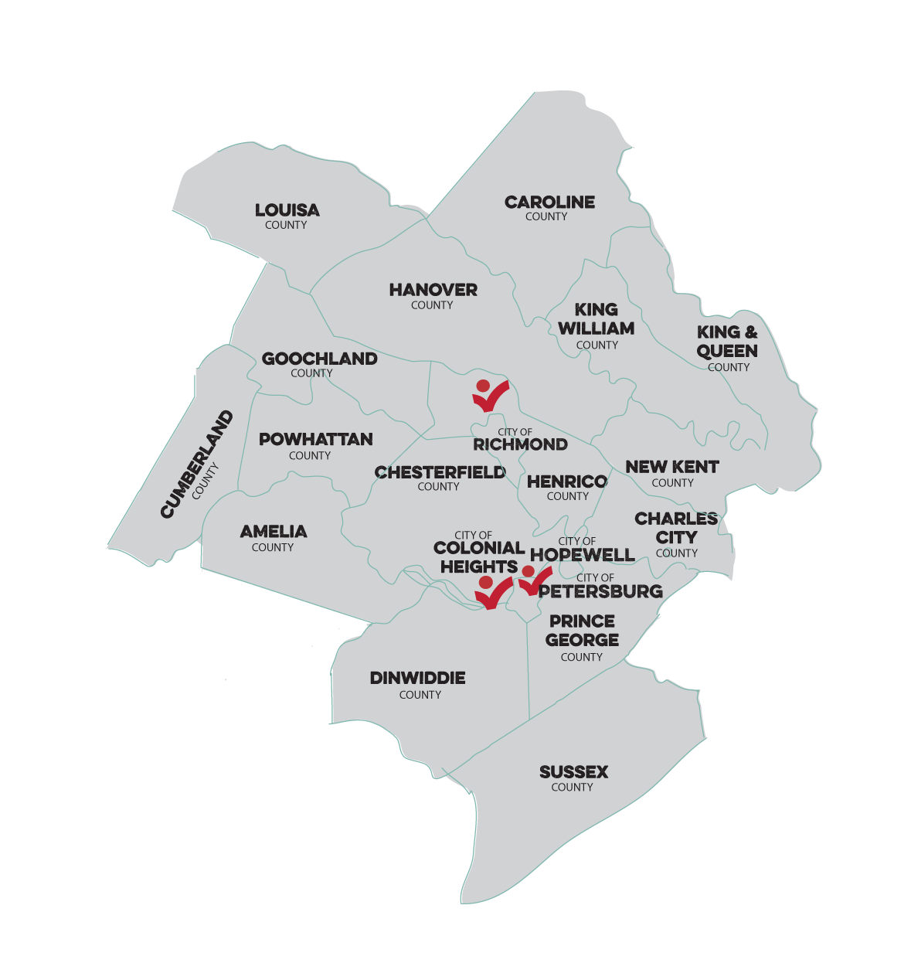

Our mission
To enable the underserved, unbanked, and no credit population to build and fulfill dreams by taking the ‘Peoples Advantage.’
Community Development Financial Institution

Slide 4
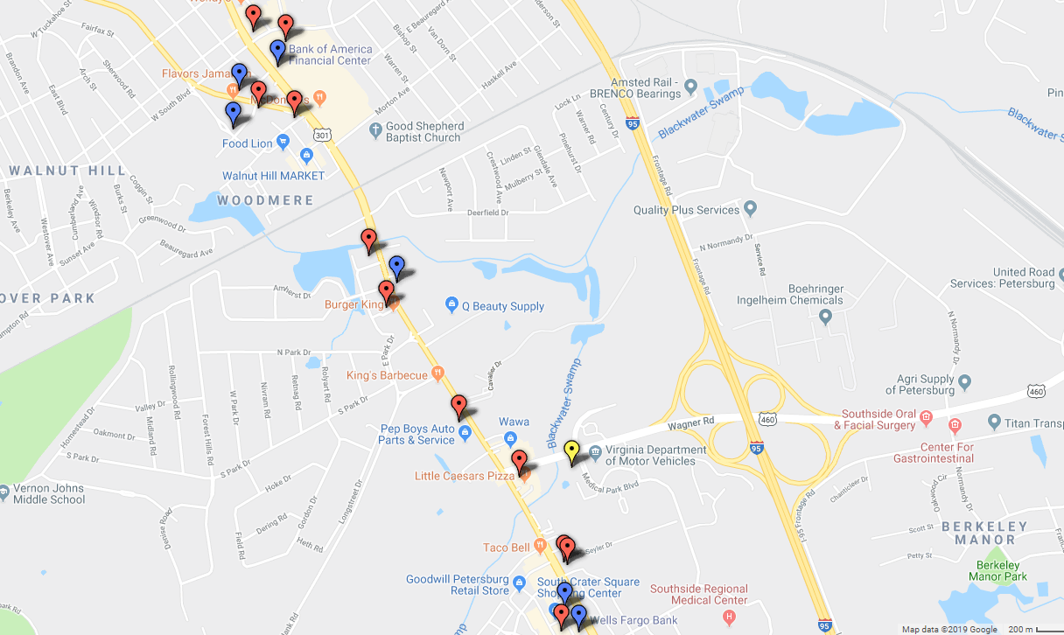



$15,582,838
Back into the community
Payday Lender
Bank
Credit Union

Slide 5
Why is affordable transportation important People’s federal credit union?
Strengthens individual and community economic development
Expands business opportunities
Creates a sense of community
Enhances safety and security
Reduces road congestion and travel times, air pollution, and energy and oil consumption
https://www.fhwa.dot.gov/policy/2002cpr/pdf/ch14.pdf

Slide 6
Our solution
$5,000 donation from PAFCU to alleviate cost to the city
Increases access to employment, health facilities, and businesses
Strengthens the financial health of the community

Slide 7
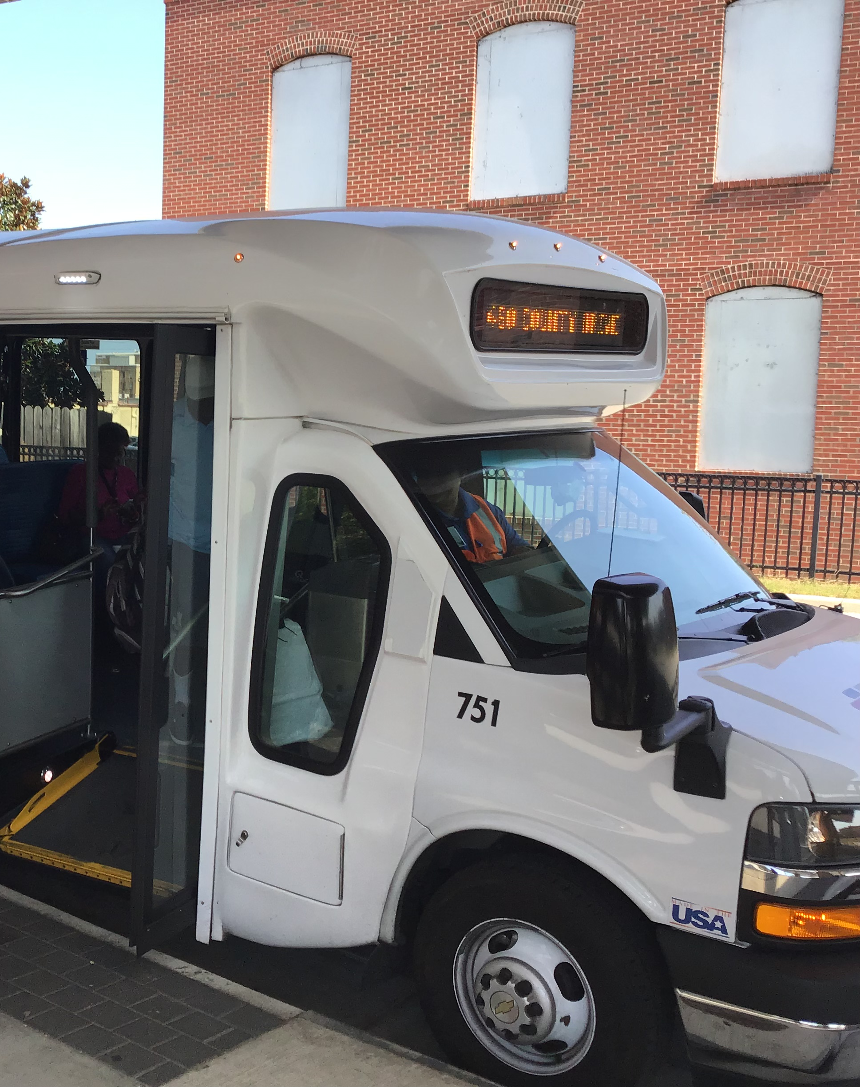
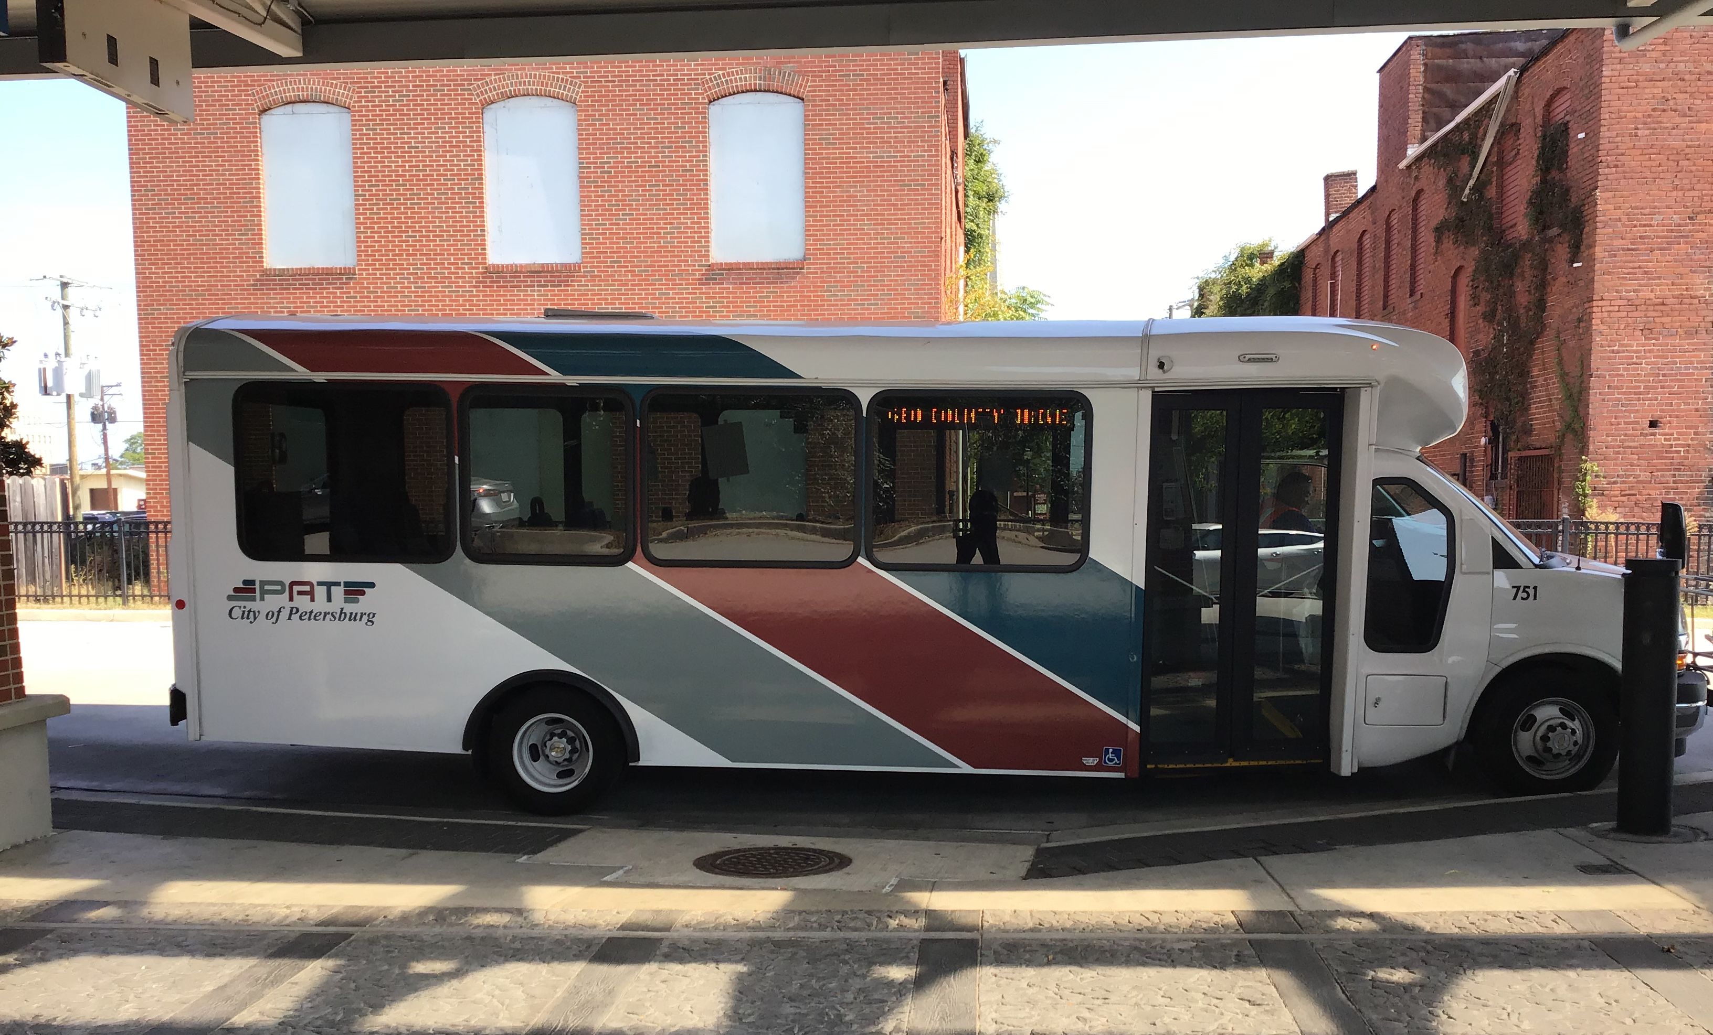
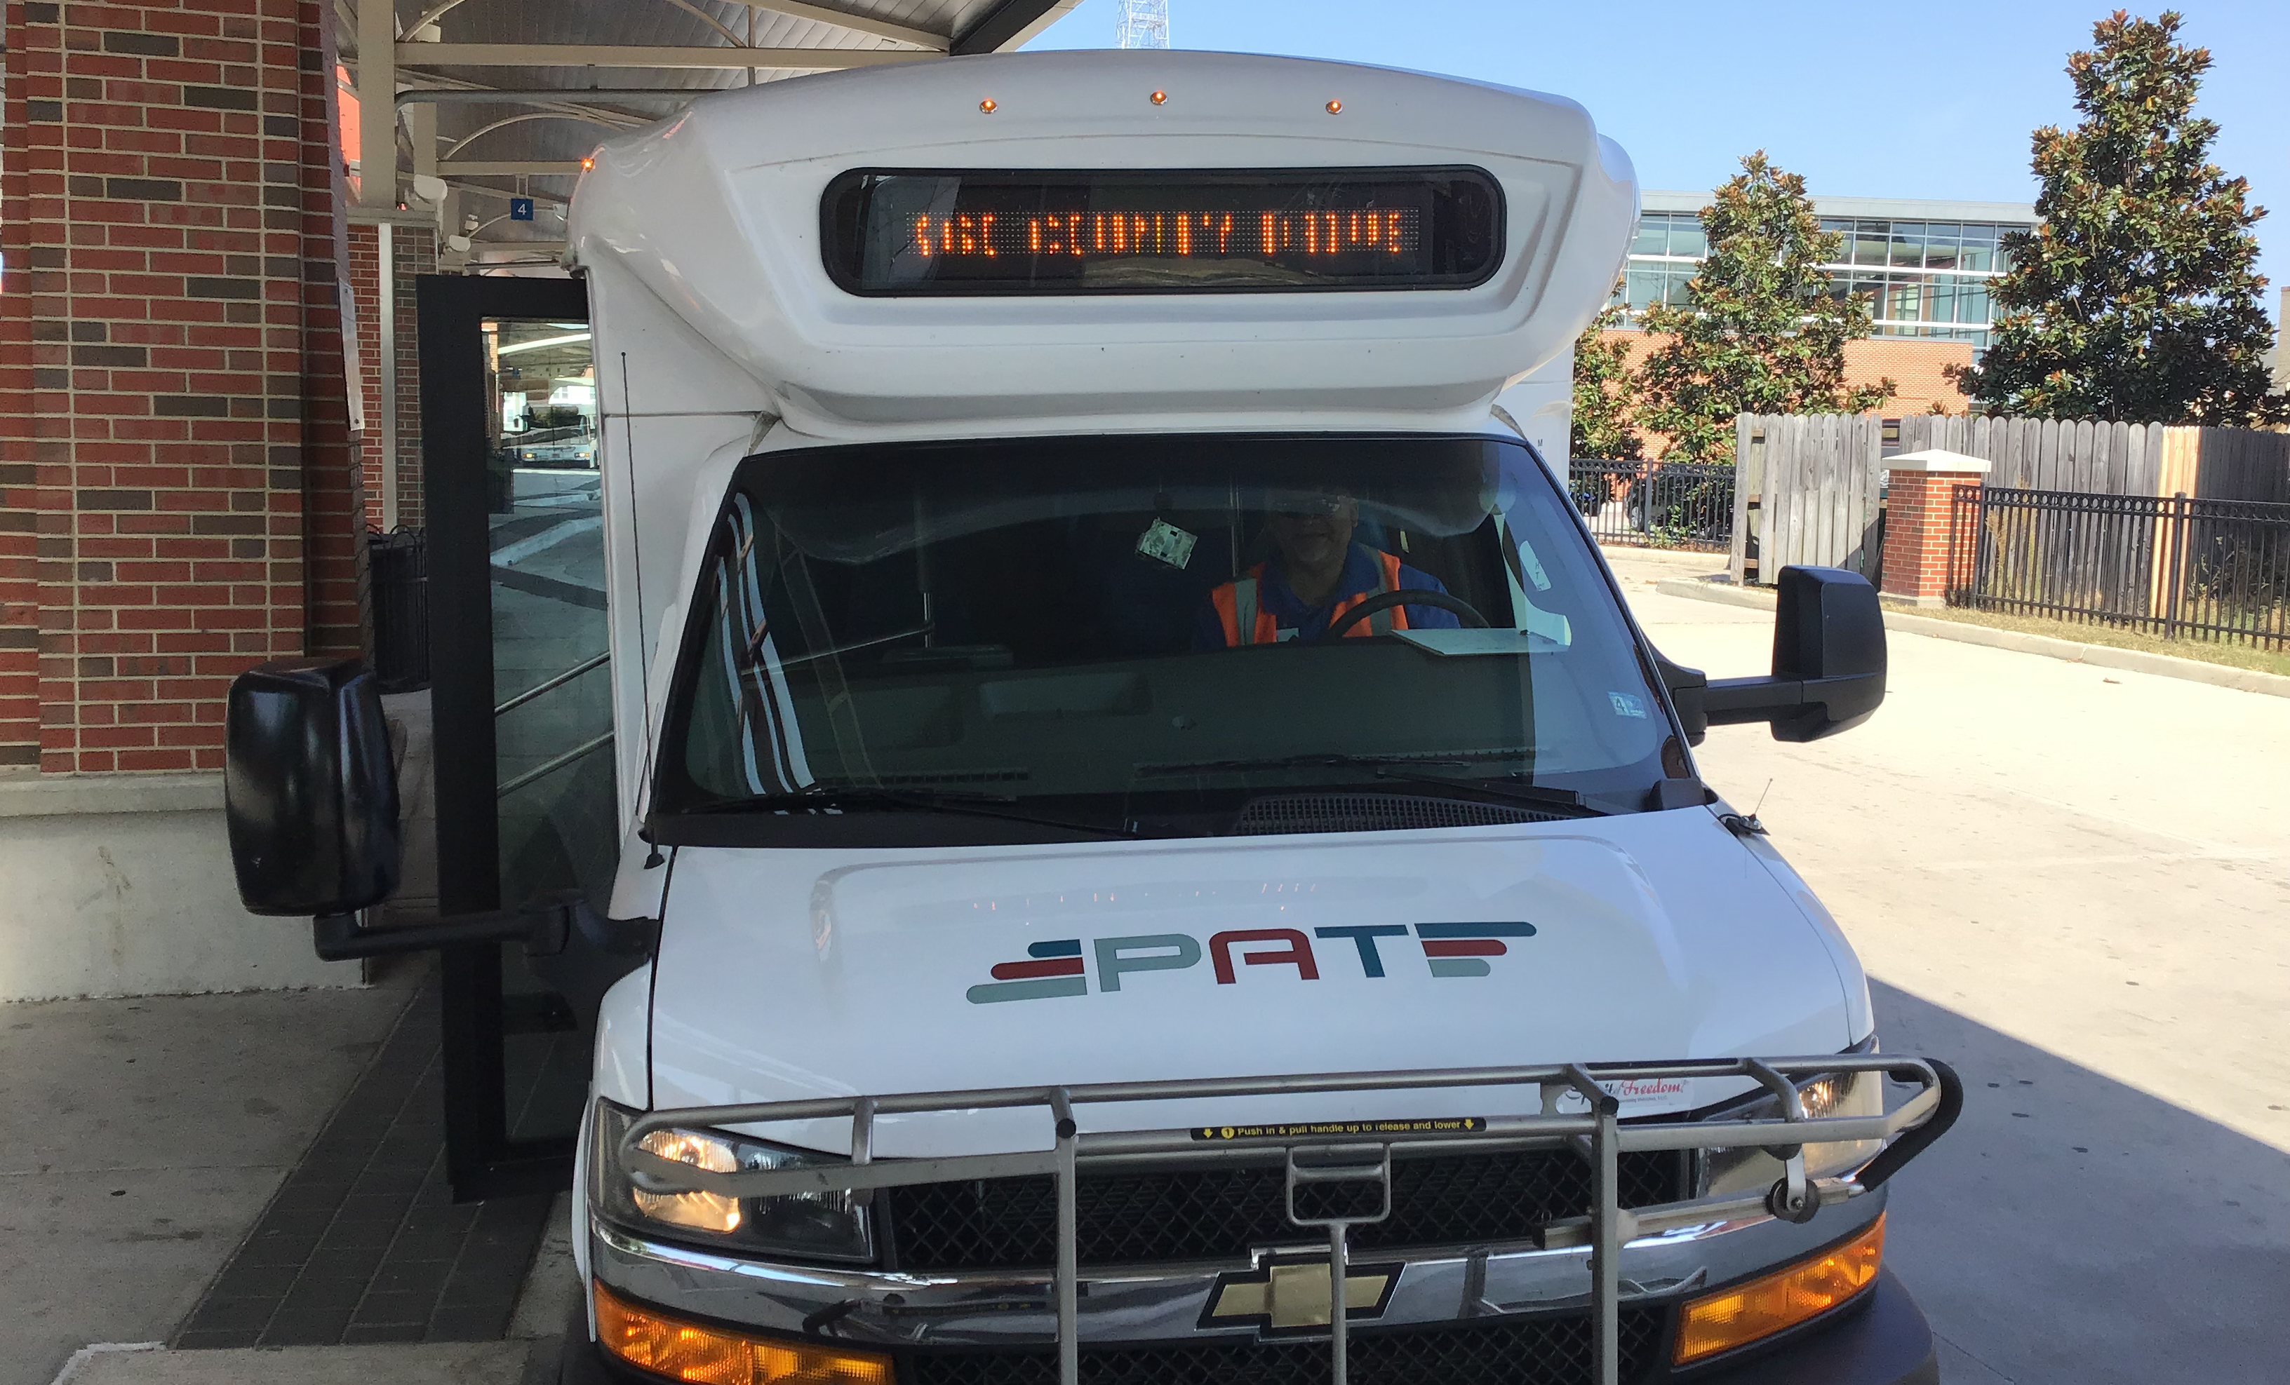
Ford 22 passenger heavy duty bus

Slide 8

Why PAT & PEOPLES ADVANTAGE FCU?
We believe that both transportation and financial education are vital to combat and overcome poverty in our communities

