Slide 1

CITY ASSESSOR’S OFFICE Brian E. Gordineer, AAS – City Assessor Br
City Assessor’s Report
Jan. 1, 2022 Reassessment January 18, 2022

Slide 2
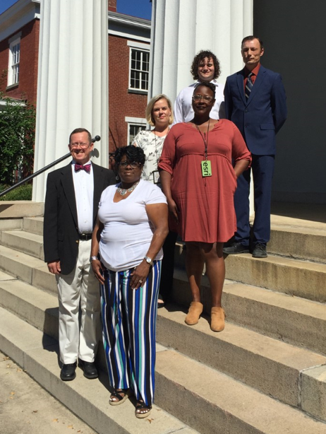
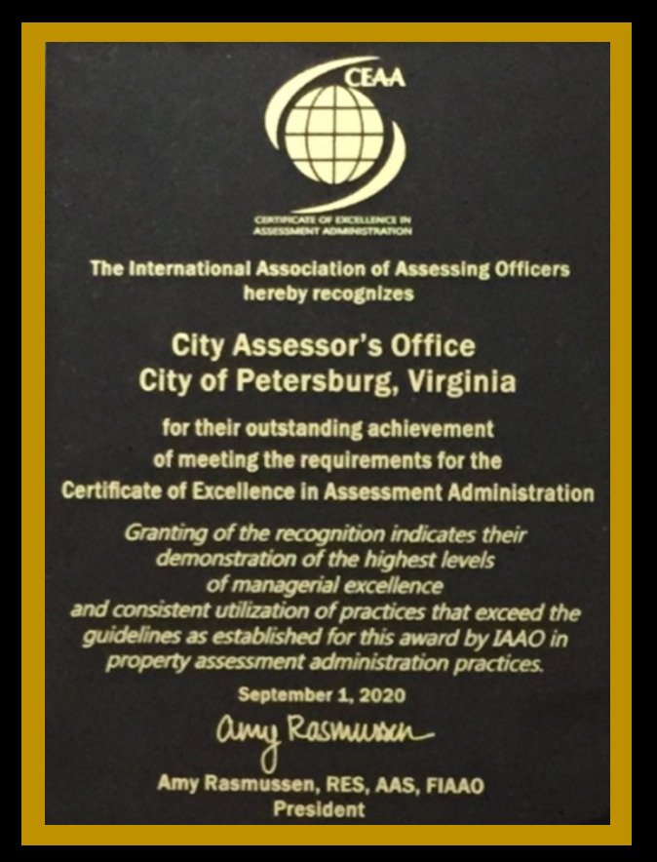
CITY ASSESSOR’S OFFICE Brian E. Gordineer, AAS – City Assessor Br

Slide 3


CITY ASSESSOR’S OFFICE Brian E. Gordineer, AAS – City Assessor Br

Slide 4
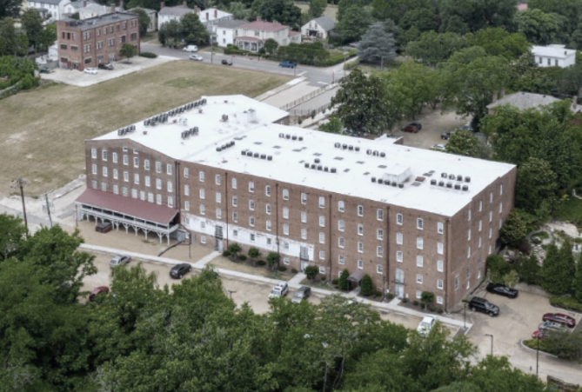
CITY ASSESSOR’S OFFICE Brian E. Gordineer, AAS – City Assessor Br
HIGH STREET
PERRY & HINTON
VA TRUNK & BAG

Slide 5
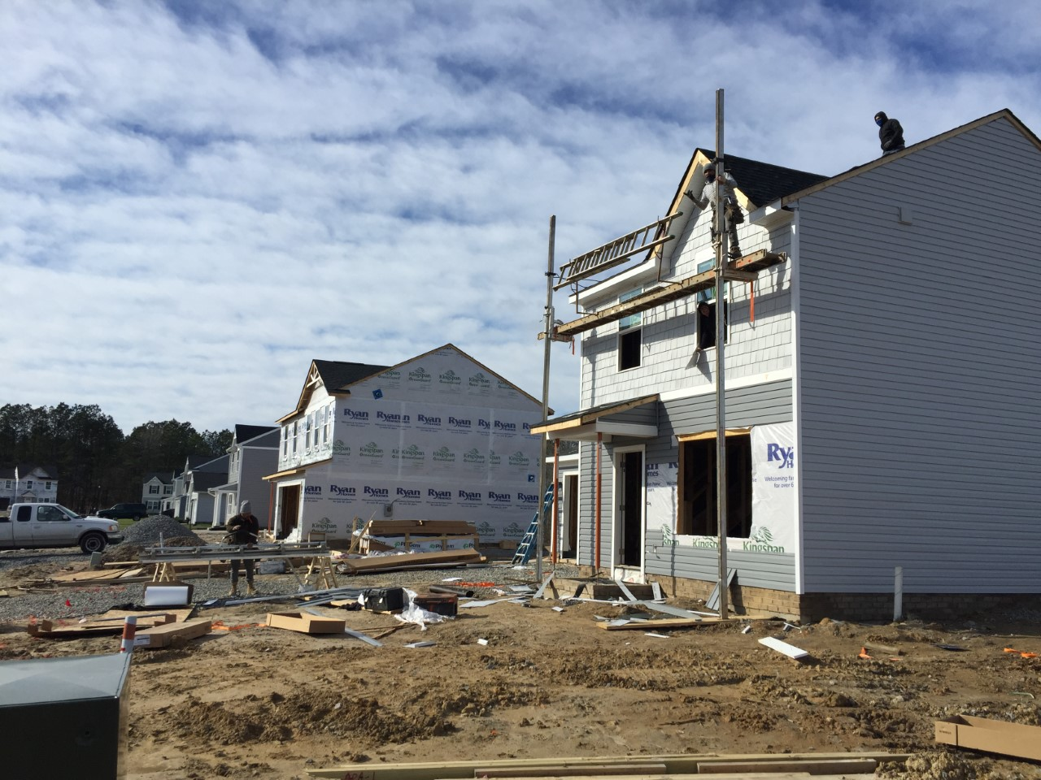
CITY ASSESSOR’S OFFICE Brian E. Gordineer, AAS – City Assessor Br
NEW HOUSES
BERKELEY ESTATES

Slide 6
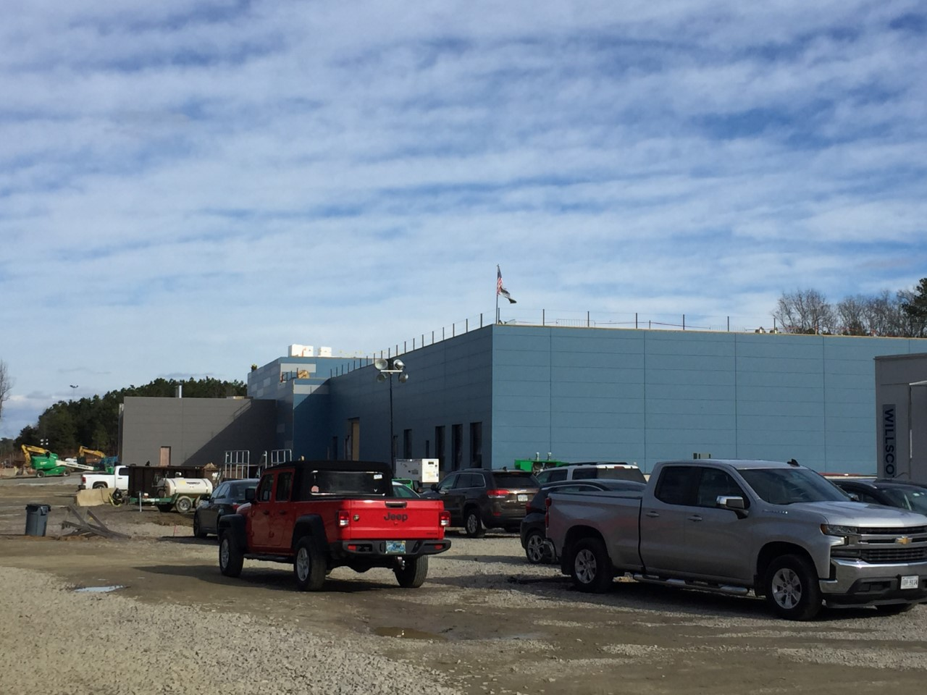
CITY ASSESSOR’S OFFICE Brian E. Gordineer, AAS – City Assessor Br
PHLOW & CIVICA

Slide 7
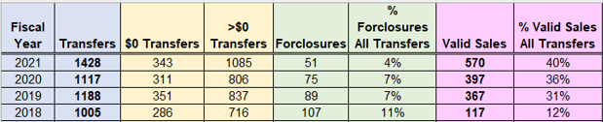
CITY ASSESSOR’S OFFICE Brian E. Gordineer, AAS – City Assessor Br
1 year
3 years
+28% +42%
Quantity

Slide 8
CITY ASSESSOR’S OFFICE Brian E. Gordineer, AAS – City Assessor Br
1 year
3 years
-32% -52%
Quality

Slide 9
CITY ASSESSOR’S OFFICE Brian E. Gordineer, AAS – City Assessor Br
1 year
3 years
+44% +387%
Quality

Slide 10
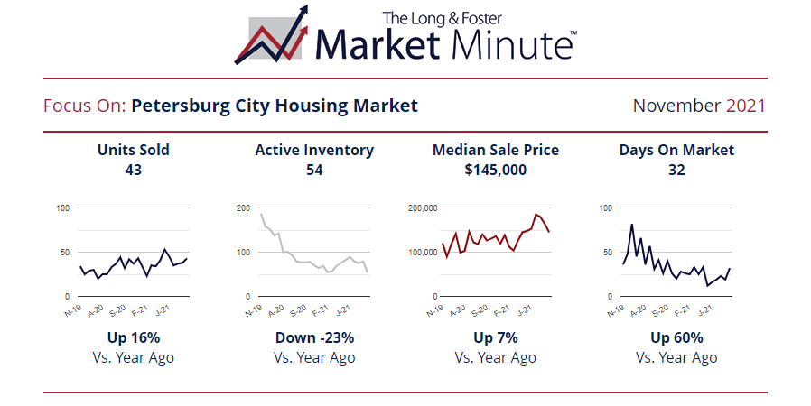
CITY ASSESSOR’S OFFICE Brian E. Gordineer, AAS – City Assessor Br
+16%

Slide 11
CITY ASSESSOR’S OFFICE Brian E. Gordineer, AAS – City Assessor Br
-23%

Slide 12
CITY ASSESSOR’S OFFICE Brian E. Gordineer, AAS – City Assessor Br
+7%

Slide 13

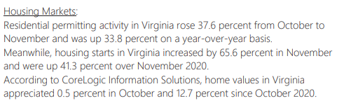
CITY ASSESSOR’S OFFICE Brian E. Gordineer, AAS – City Assessor Br

Slide 14
CITY ASSESSOR’S OFFICE Brian E. Gordineer, AAS – City Assessor Br

Slide 15
CITY ASSESSOR’S OFFICE Brian E. Gordineer, AAS – City Assessor Br

Slide 16
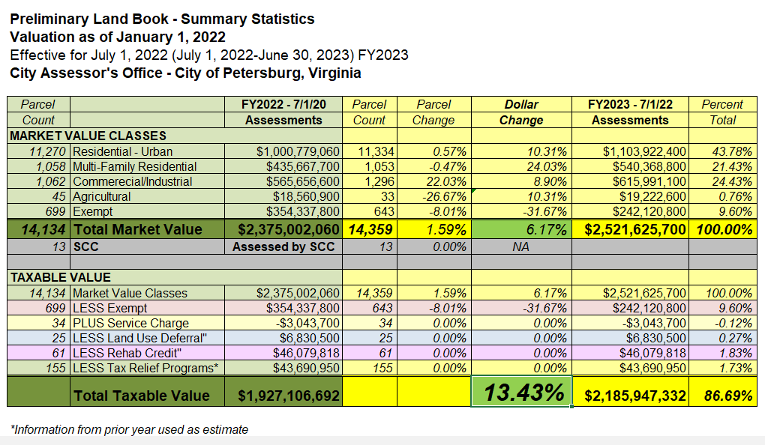
CITY ASSESSOR’S OFFICE Brian E. Gordineer, AAS – City Assessor Br

Slide 17
CITY ASSESSOR’S OFFICE Brian E. Gordineer, AAS – City Assessor Br
Residential +10%
Multi-Family +24% Commercial +9% Agricultural +10%
44% of Land Book

Slide 18
CITY ASSESSOR’S OFFICE Brian E. Gordineer, AAS – City Assessor Br
Residential +10%
Multi-Family +24% Commercial +9% Agricultural +10%
21% of Land Book

Slide 19
CITY ASSESSOR’S OFFICE Brian E. Gordineer, AAS – City Assessor Br
24% of Land Book
Residential +10%
Multi-Family +24% Commercial +9% Agricultural +10%

Slide 20
CITY ASSESSOR’S OFFICE Brian E. Gordineer, AAS – City Assessor Br
Residential +10%
Multi-Family +24% Commercial +9% Agricultural +10%
1% of Land Book
////

Slide 21
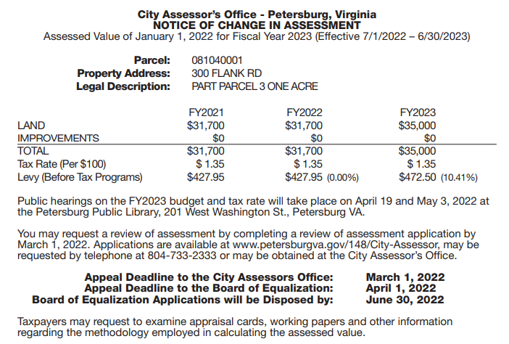
CITY ASSESSOR’S OFFICE Brian E. Gordineer, AAS – City Assessor Br
14359 Parcels value change 10658 Changes +7% 1263 Decreases -12%
9375 Increases +10%

Slide 22
CITY ASSESSOR’S OFFICE Brian E. Gordineer, AAS – City Assessor Br
Postcards Jan. 28 Office Reviews Mar. 1 Board of Equalization Apr.1

