Slide 1

2025-REZ-03: Consideration of an ordinance to approve a request by Alexander Graham, Jr., on behalf of the Warrenton Group, to rezone property at 2233 Halifax Road, Parcel ID 076030800, from the A Agricultural District to the M-1 Light Industrial District with proffers
City council Meeting
April 2025

Slide 2
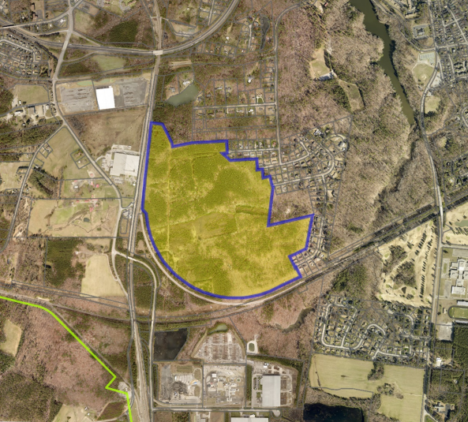
Subject Property
I-85
Halifax Road

Slide 3
Request Overview
Rezone to M-1, Light Industrial to construct data center development
Currently zoned A, Agricultural
Proffers included for consideration
Property owned by City, under option-agreement with Warrenton Group

Slide 4
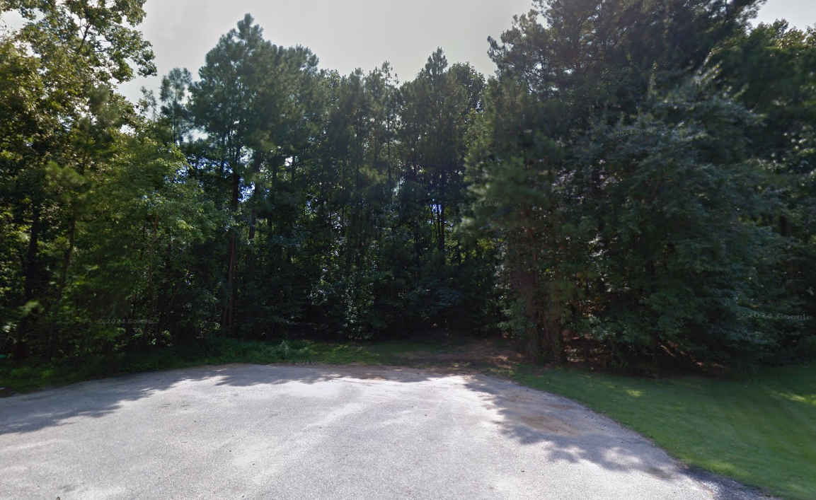
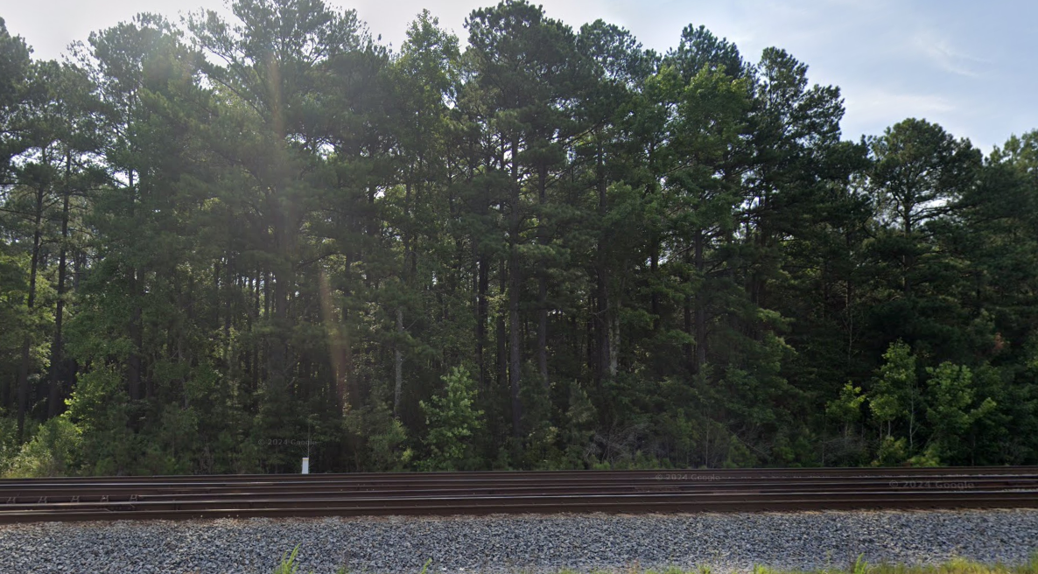
Existing Conditions

Slide 5
Proposed Use
Data center development with 6 data center buildings, two-stories in height, and 145,000 square feet in area
Two substations approximately 4.5 acres in area each
Site access for construction and operation from Halifax Road; residential street access for emergencies and utility infrastructure maintenance
Certain site components are subject to change as final site design is completed

Slide 6
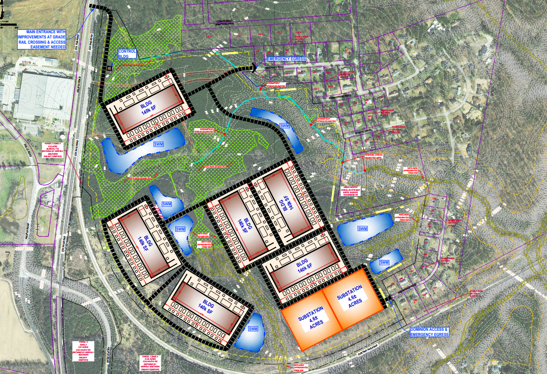
Concept Plan

Slide 7
Data Center Regulations
A minimum 100-foot setback for all principal structures from any property line abutting a residential property or park
A vegetated buffer consisting of an earthen berm and a combination of plantings along any property line shared with a residence or park
Pre- and post-construction noise studies to demonstrate that the noise from the development will not exceed maximum levels permitted by the City’s noise ordinance at any property line shared with a residence or park
Sound mitigation for all mechanical equipment
A minimum 35-foot setback for any anti-intrusion fencing from any public street
Usage a closed-loop cooling system if water-based cooling is used unless an exception is granted by the Director of Public Works.

Slide 8
Proffers
There will be minimum 100-foot setbacks from residential properties for all principle structures, including substations, as required by the Zoning Ordinance. Where possible, these setbacks will be increased.
The data center buildings and substations will be designed with architectural treatment features to be reviewed by Planning staff during site plan and permit review.
An enhanced landscape buffer will be provided along the property lines shared with residential properties. A landscaping plan with specific plantings will be provided for staff review during site plan review.
Pre and post-construction noise studies will be completed as required by the Zoning Ordinance and noise levels will not exceed those prescribed in City Code. Additionally, generator testing will be limited to weekdays between 8:00 a.m. and 5:00 p.m.
Recycled water will be used if a water-based cooling system is utilized.

Slide 9
Proffers – cont.
The applicant will advocate that the extension of any electric or gas infrastructure needed to power the development be routed to avoid residential development.
The applicant will work with the Department of Environmental Quality (DEQ) and the Army Corp of Engineers to avoid or mitigate any wetland or stream impacts. If any historic archaeological features are identified on the site, the applicant will negotiate protection of those features during site plan review.
Access to the site during construction and operation of the facilities will be provided from Halifax Road and residential streets will only be used for emergency access or access for utility infrastructure.
The applicant will work to abandon existing easements on the site and where that is not possible, will work to accommodate any easement restrictions.
Any new utility infrastructure will be brought for review by the Planning Commission for accordance with the City’s Comprehensive Plan.

Slide 10
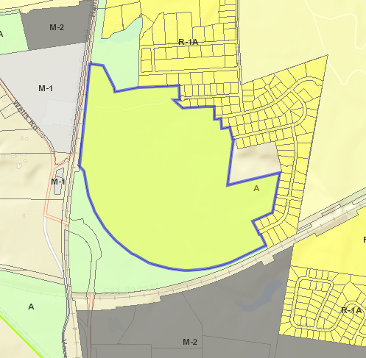
Adjoining Zoning/Uses
To the north and east - primarily residential, including the Ramblewood subdivision.
To the south - CSX railroad, but uses south of the railroad are Industrial -
Bleachtech, Infra-Metals, and Allan Myers Asphalt Plant.
To the west - CSX railroad and Halifax Road. Uses across Halifax Road are industrial - International Paper.

Slide 11
Comprehensive Plan Considerations
General Industrial on Future Land Use Map
Areas readily accessible by road and rail and are where heavy industrial uses should be sited
Where bordering residential development, ample setbacks and buffering should be provided
Where sites are largely impervious, adequate elements for stormwater management should be provided and environmental justice considerations should be addressed
Primary land uses include business and employment uses, logistics and distribution, and moderate to heavy industrial uses like factories or lumberyards
Development principles include the use of high-quality building materials, incorporation of environmentally friendly practices, like low-impact and energy-efficient designs, adequate landscaping, setbacks, and buffers, and effective access management

Slide 12
Recommendations
Planning Commission - Approval of rezoning with proffers, as drafted, in an 8 ayes to 0 nays vote.
Staff - Approval of the rezoning with the proffers submitted, but would recommend the applicant explore and capitalize on any opportunities to exceed the minimum standards in the Zoning Ordinance.

Slide 13
Sample Motion
I move that we APPROVE/DENY/AMEND an ordinance to approve a request to rezone property at 2233 Halifax Road from the A, Agricultural, District to the M-1, Light Industrial, District with proffers.
IF DENIED: state the reason why.
IF AMENDED: with the following amendment…

